Slide 1
Survey Comparison Project Figures

Slide 2
SVC vs. Roving Surveys

Slide 3
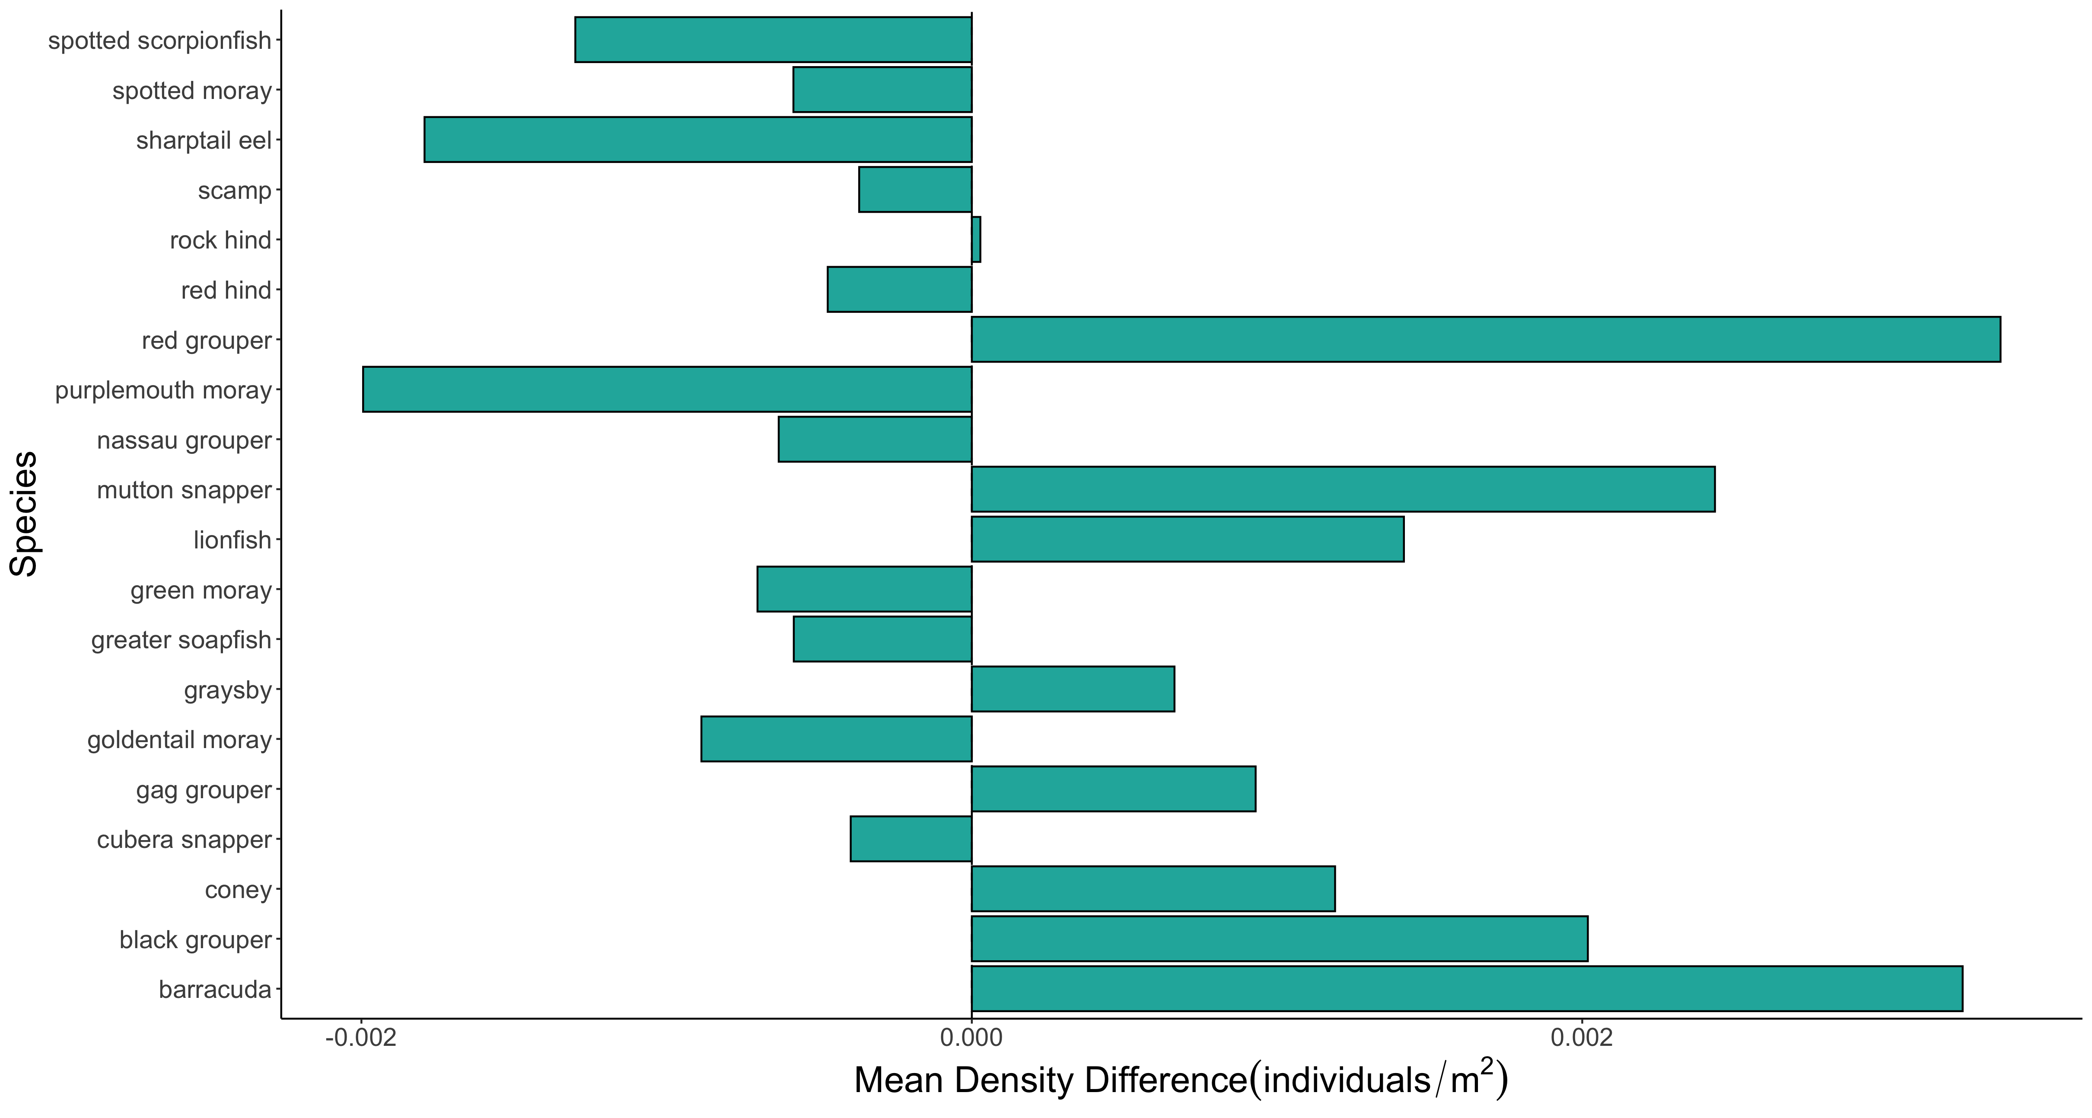

Slide 4
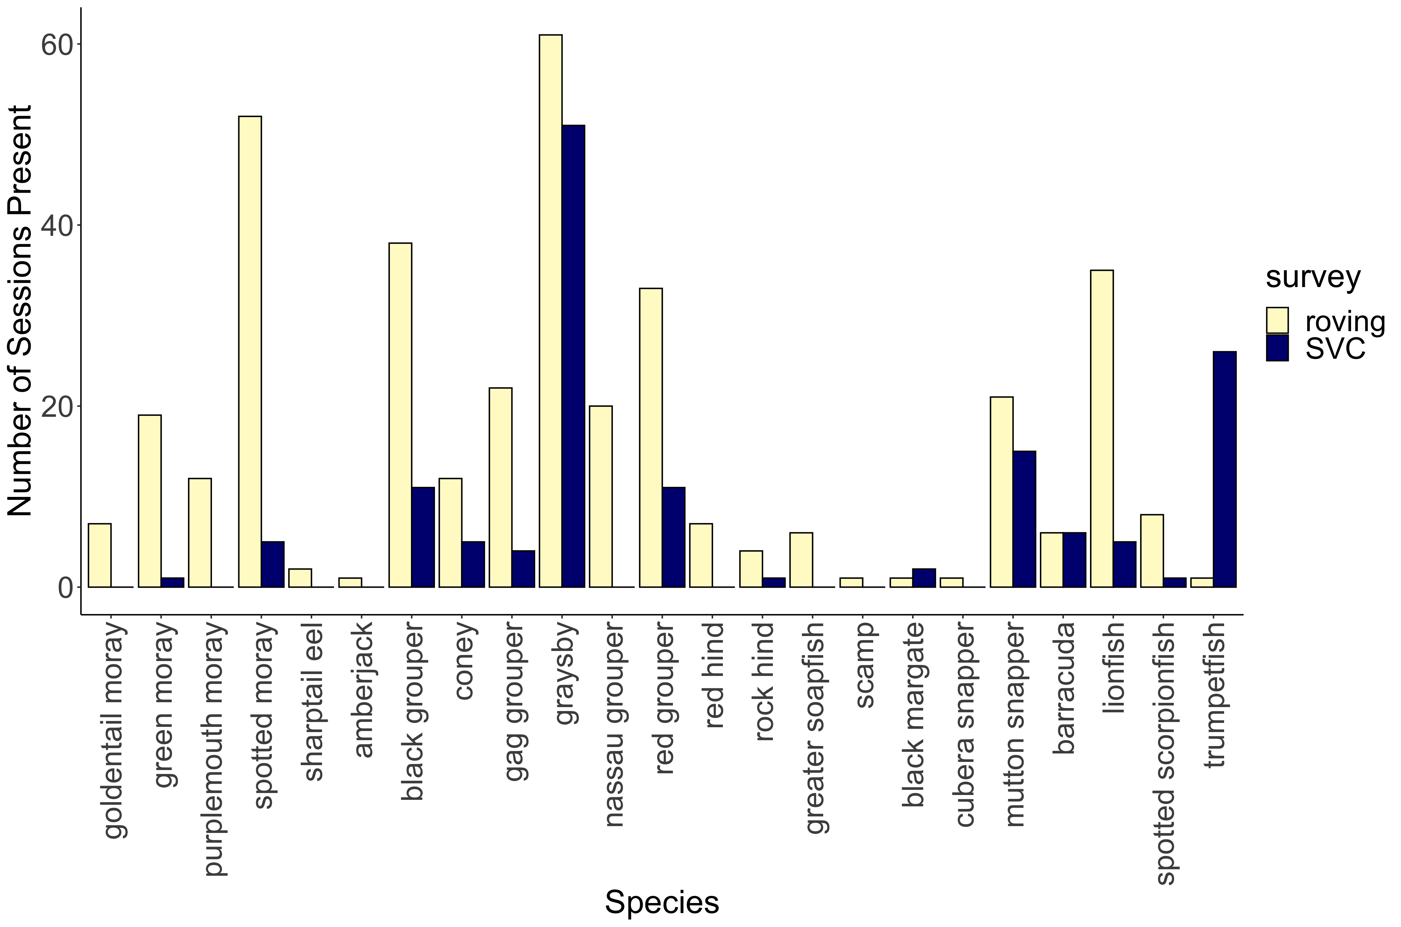
***
***
***
***
***
***
***
***
**
*
*
*
*

Slide 5
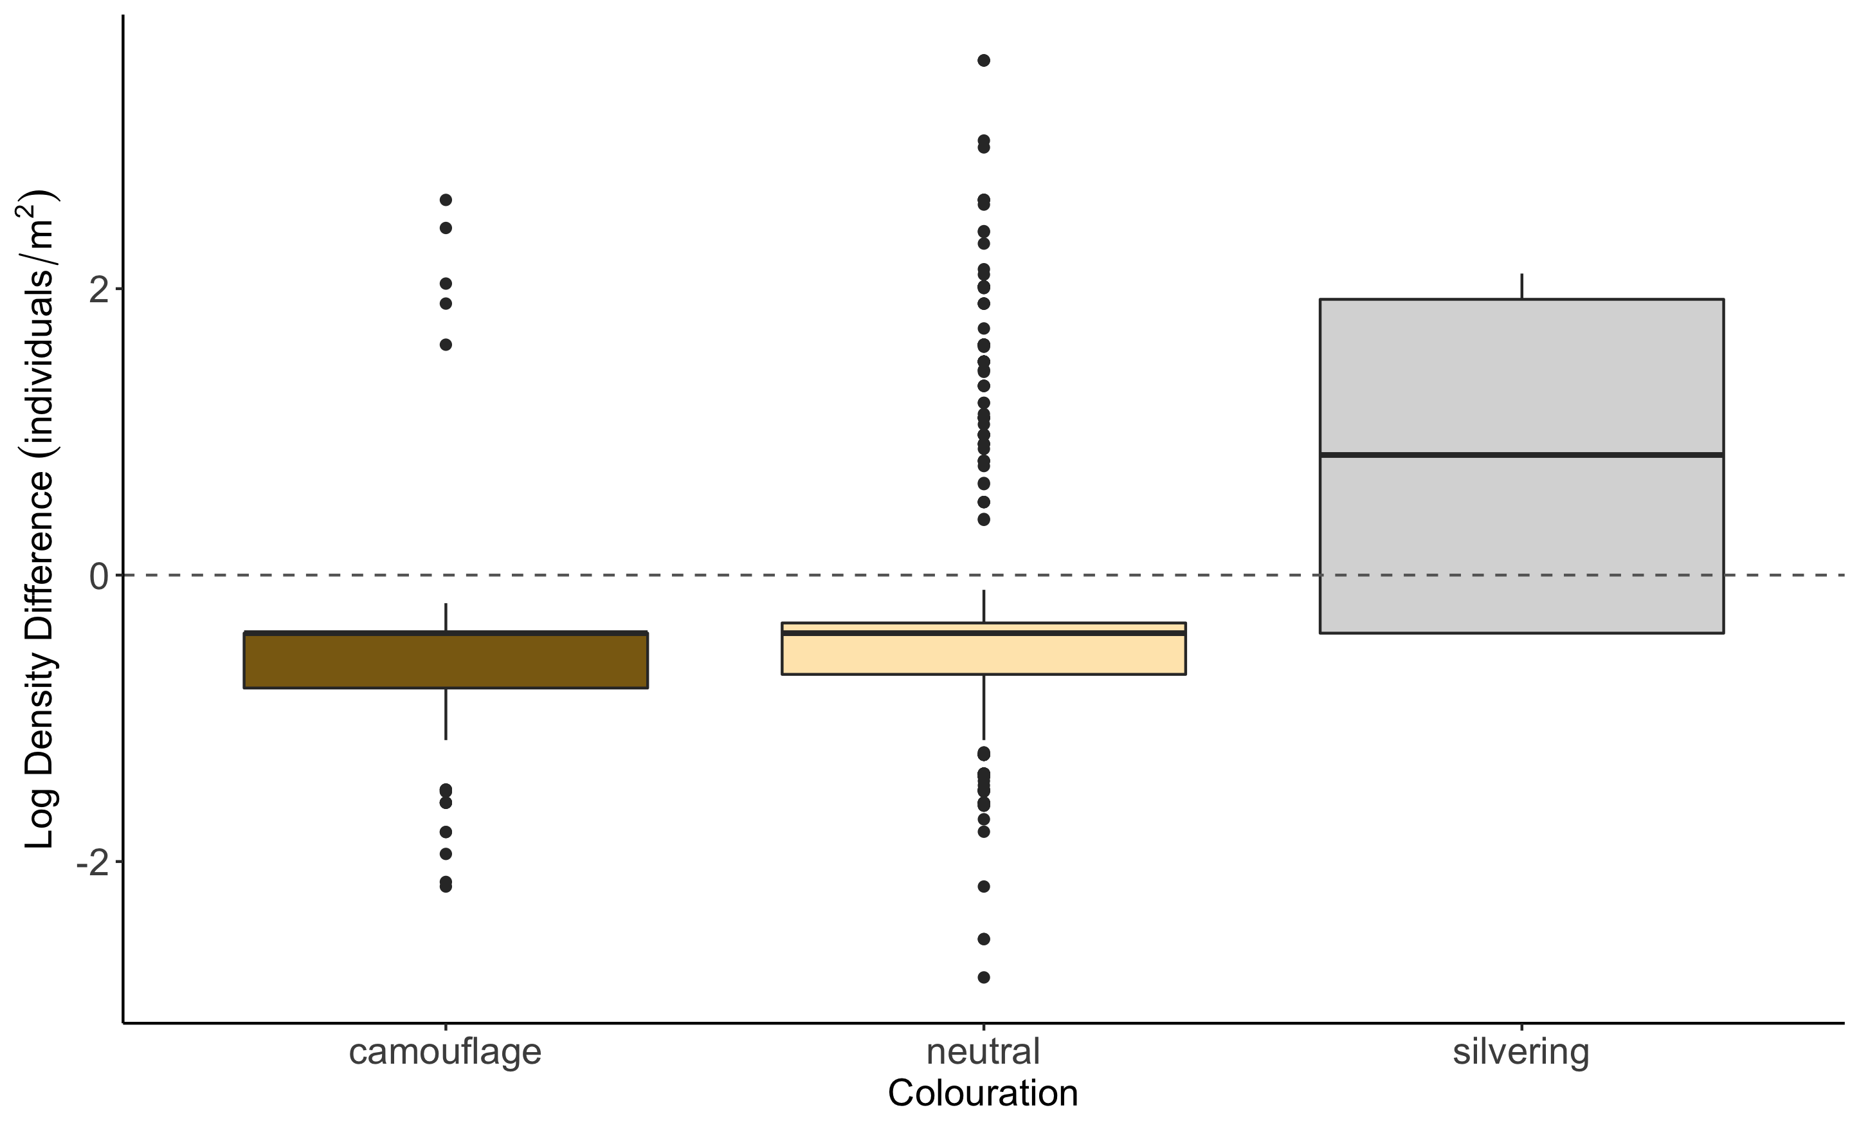
b
a
c

Slide 6
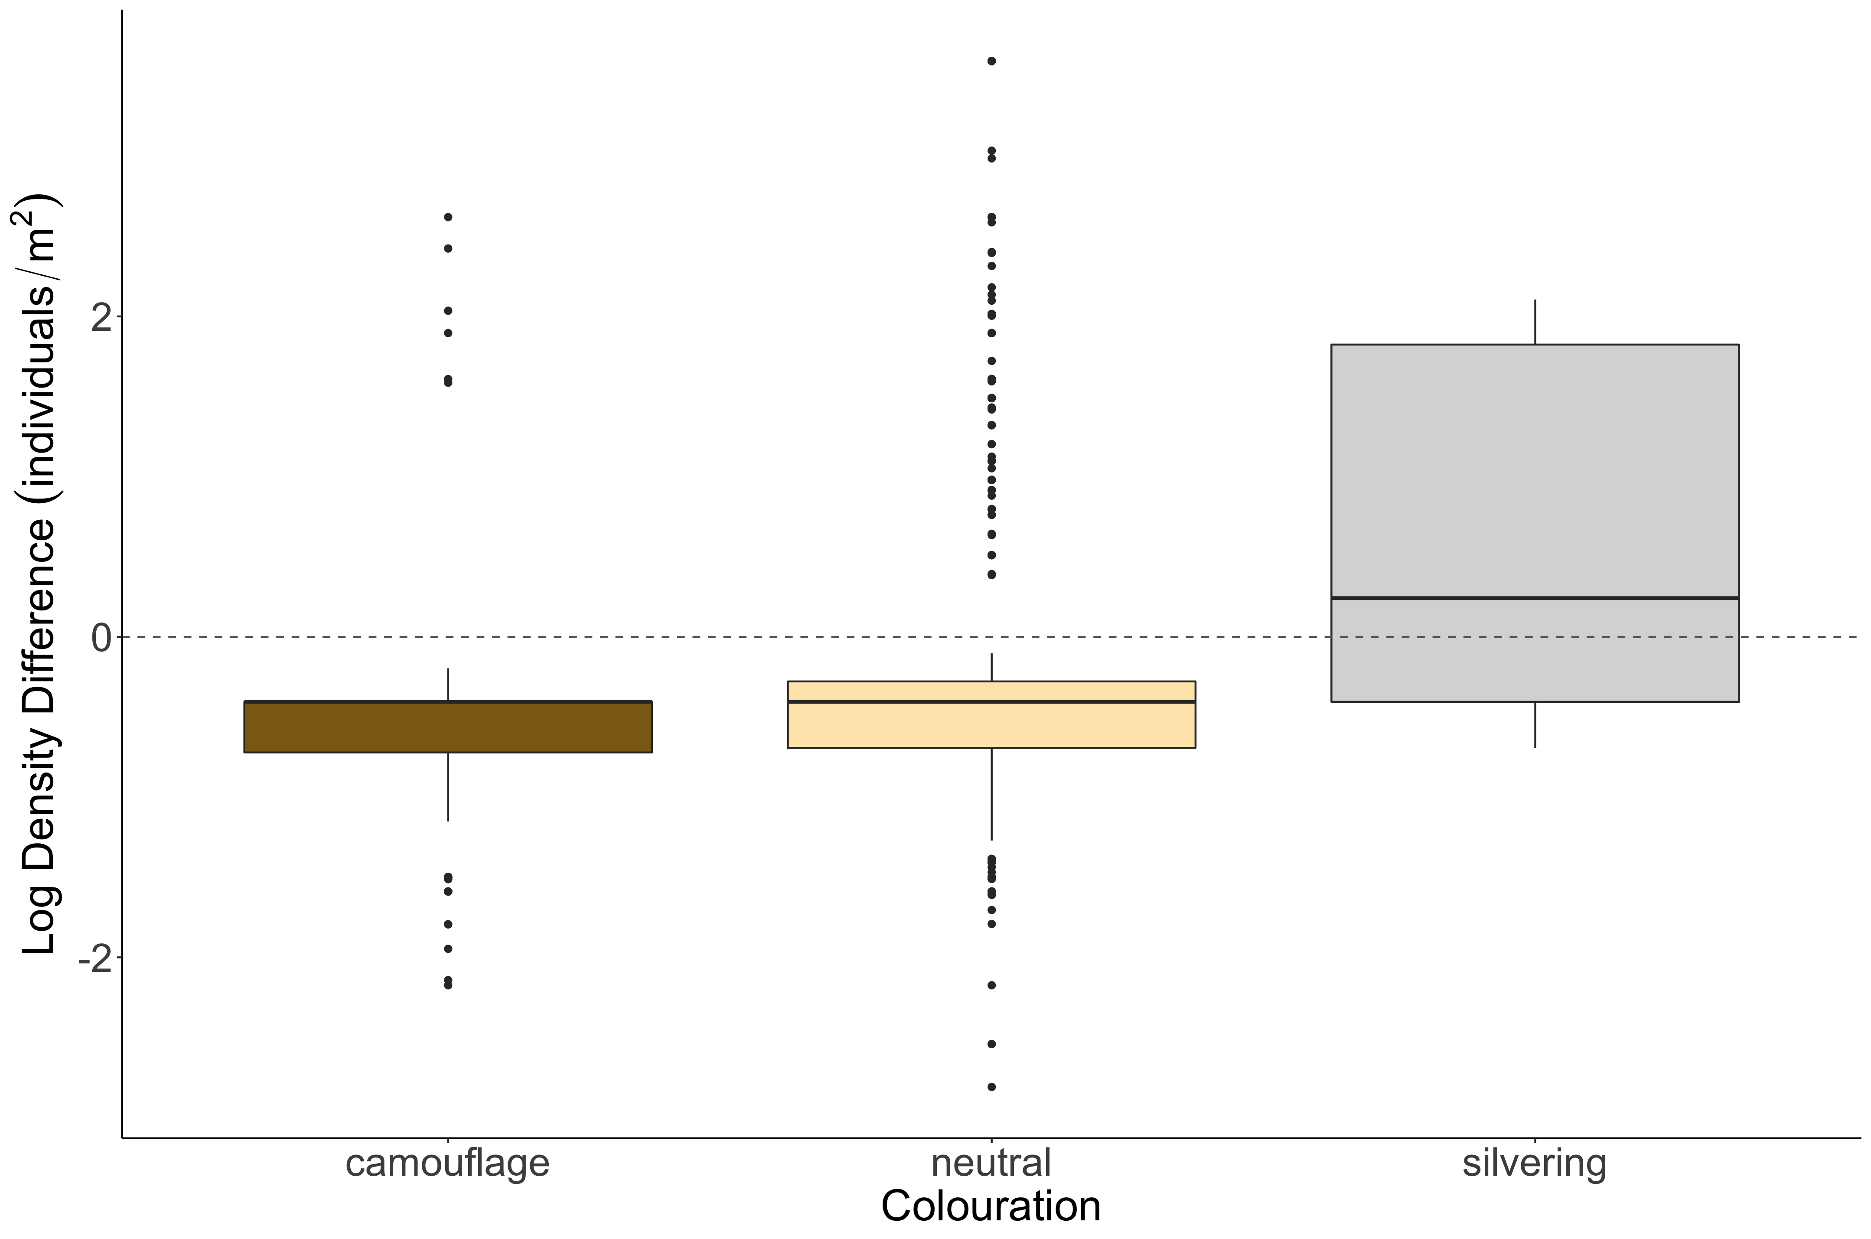
b
a
c

Slide 7
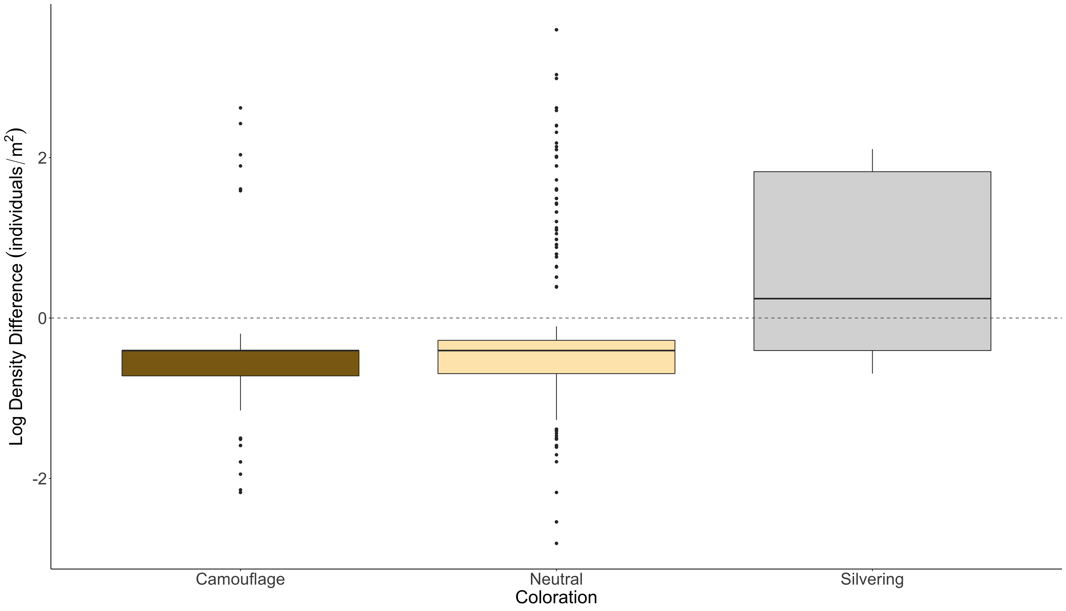
b
a
c

Slide 8
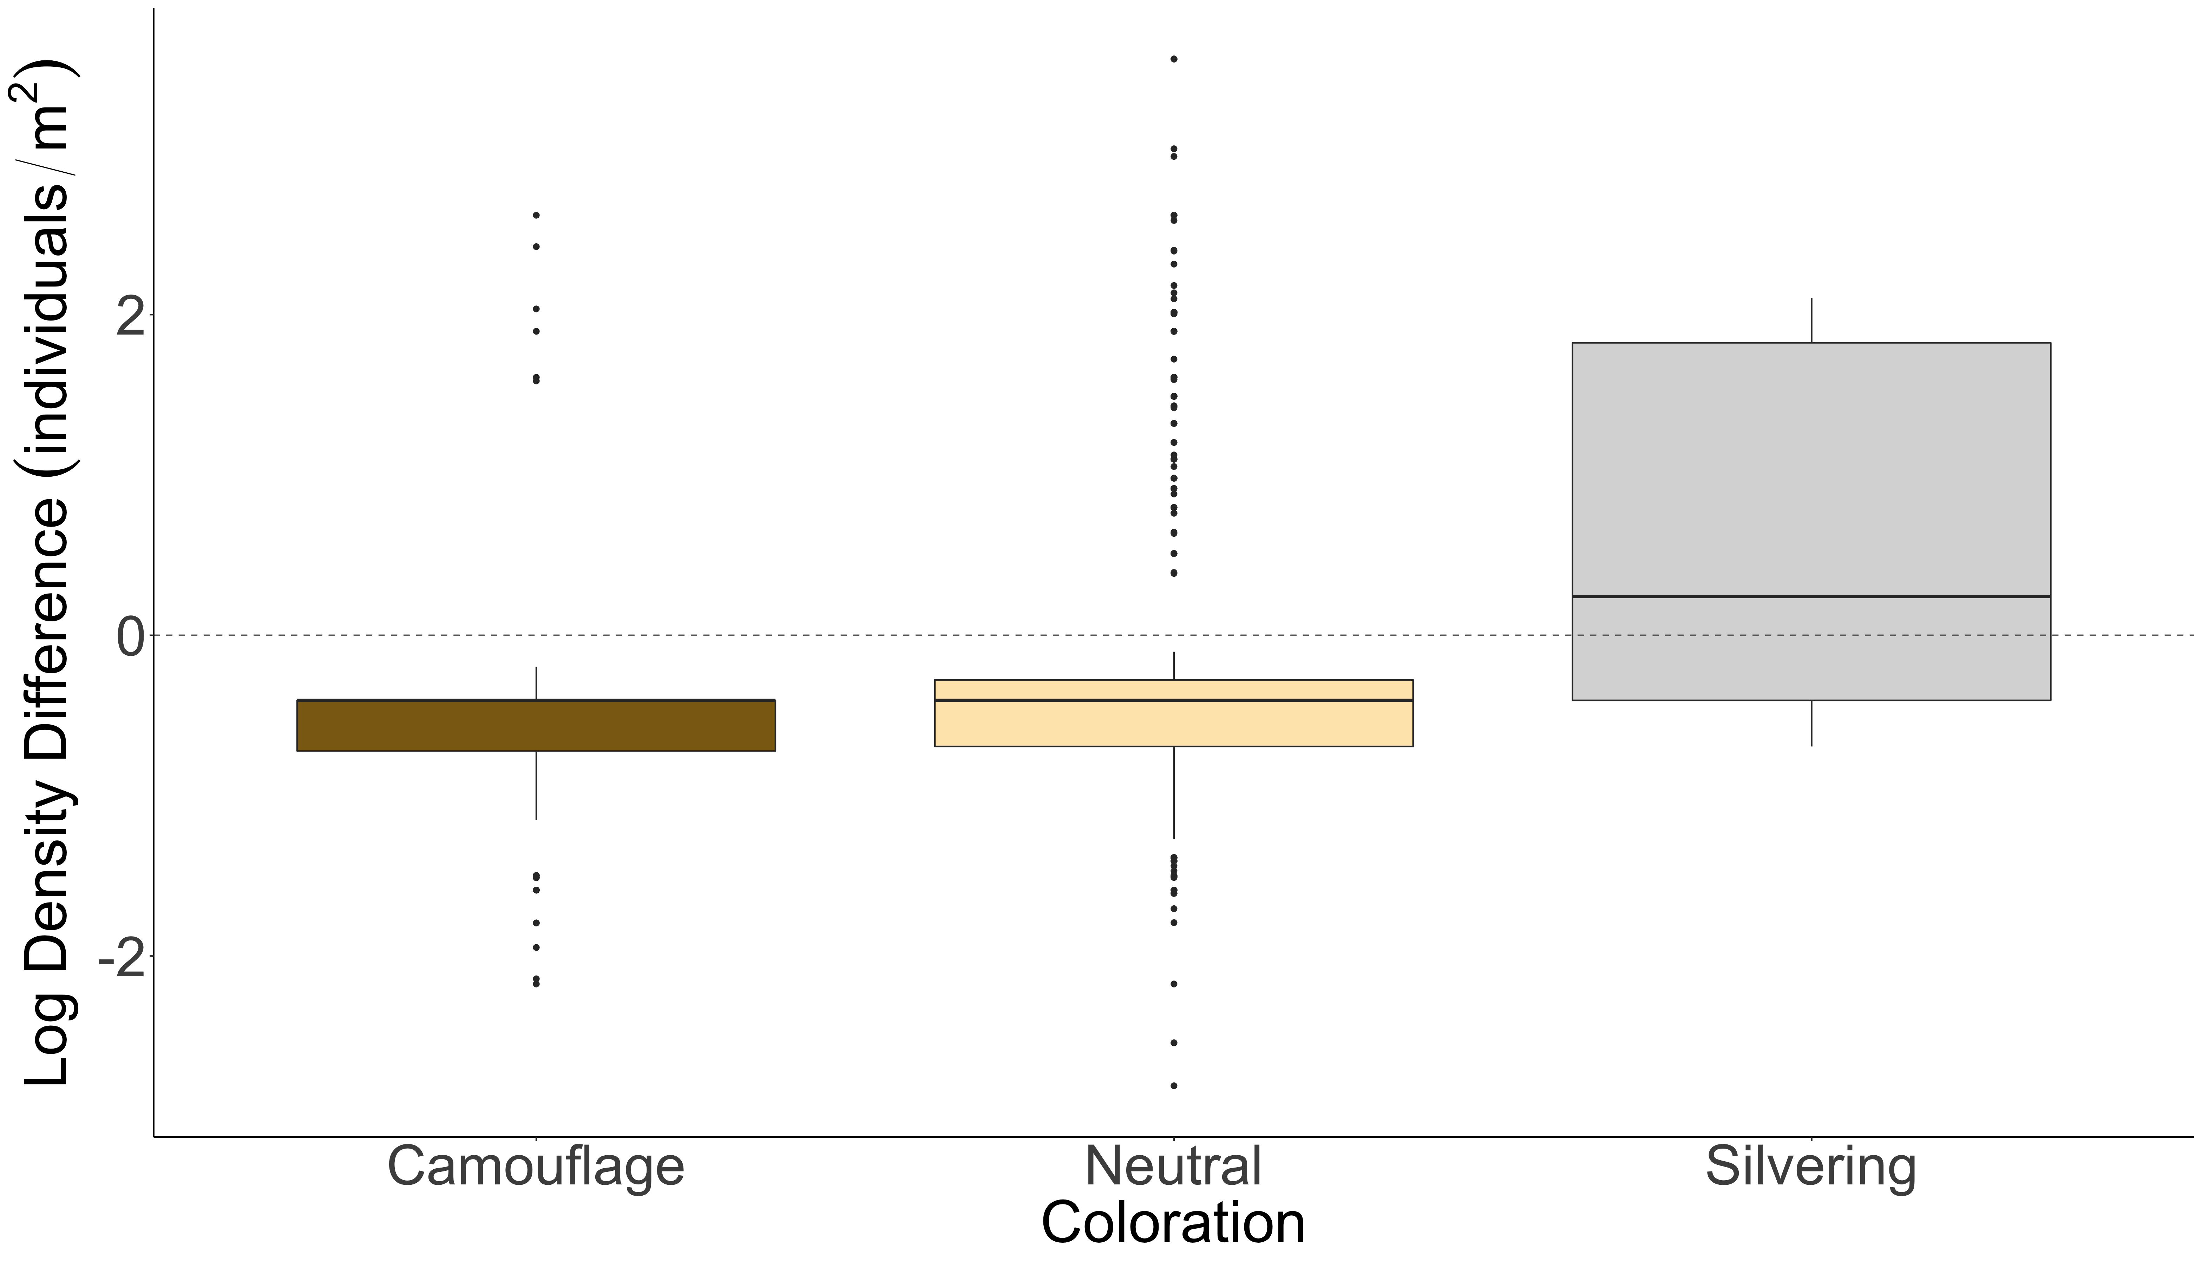
b
a
c

Slide 9
b
a
c
SVC
Density Greater
Roving Density Greater

Slide 10
SVC vs. Transect Figures

Slide 11
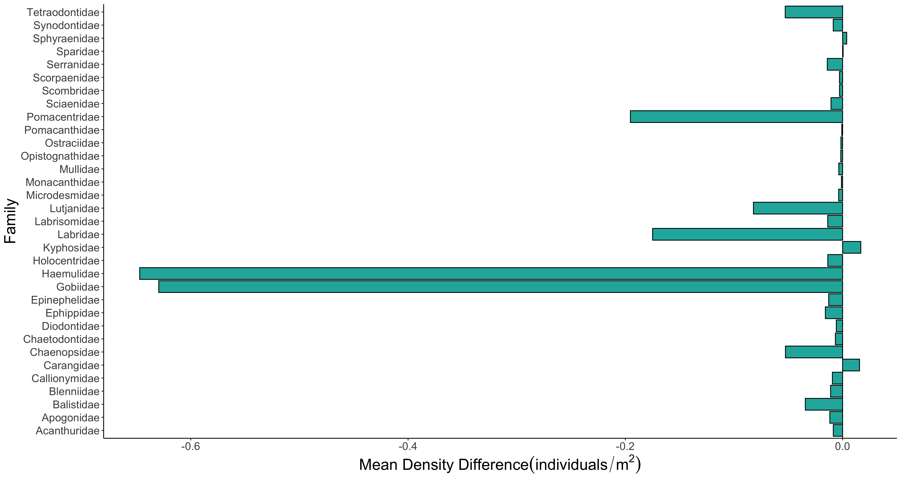

Slide 12
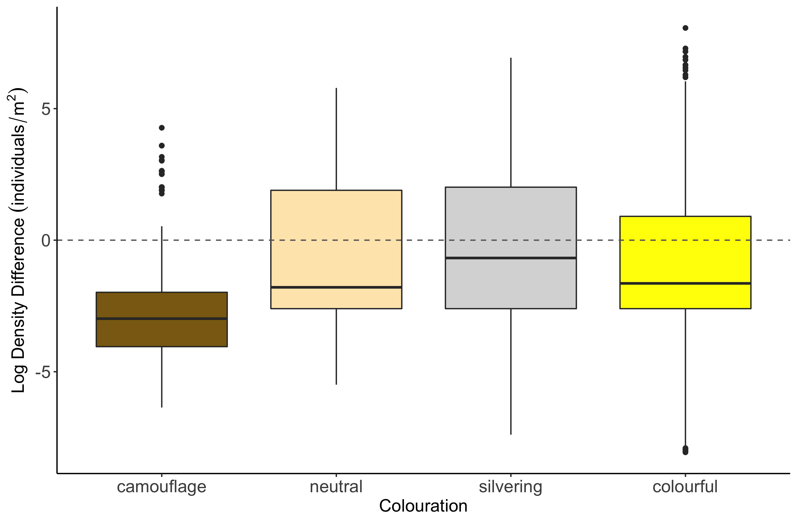
c
b
b
a

Slide 13
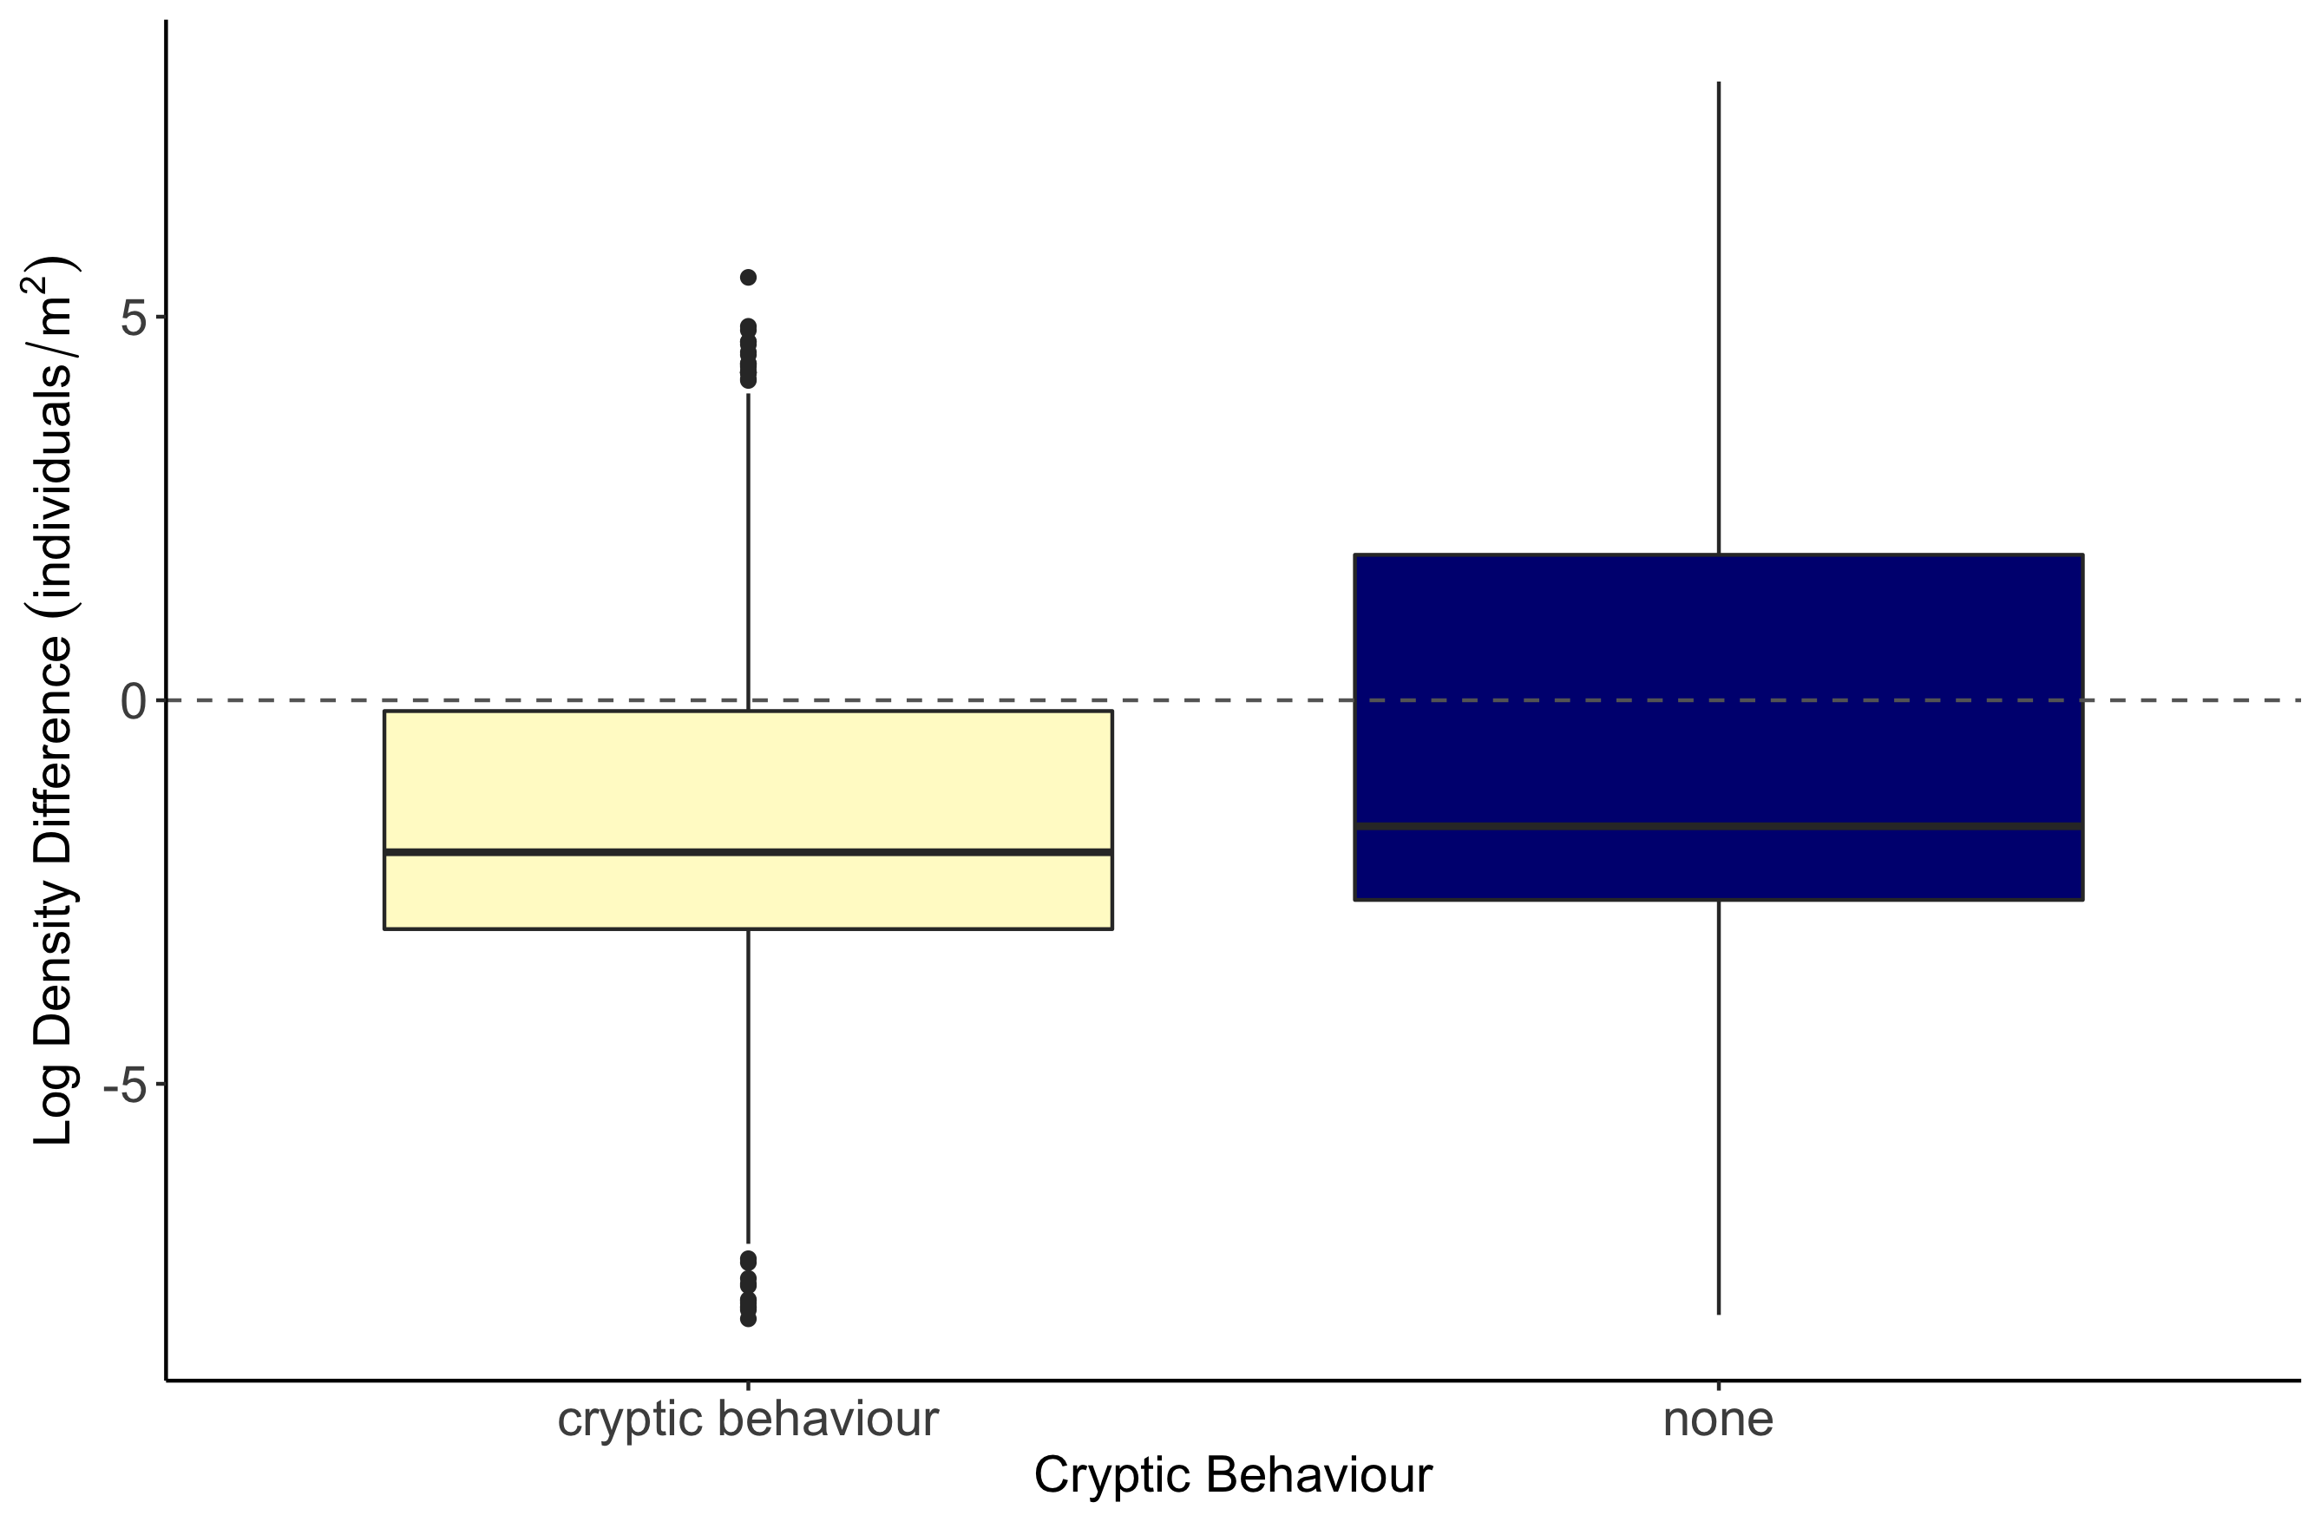
b
a

Slide 14
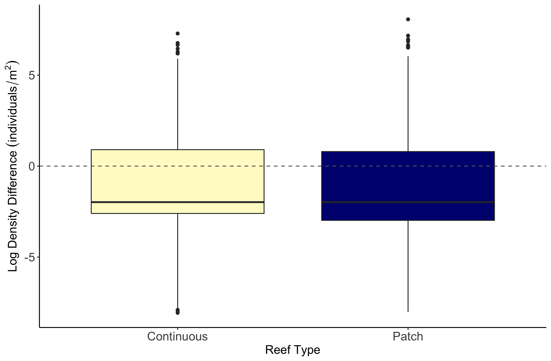
b
a

Slide 15
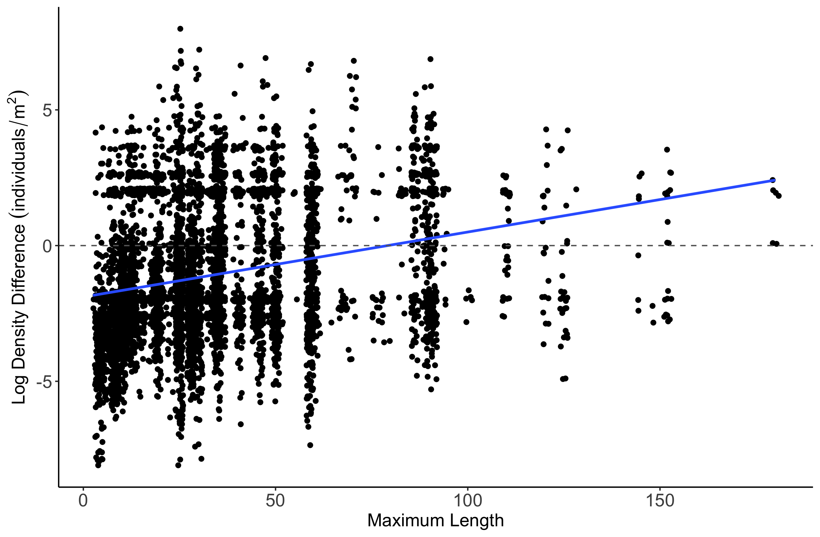
Estimate = 0.0077157
z value = 4.307
p-value = 1.65e-05

Slide 16
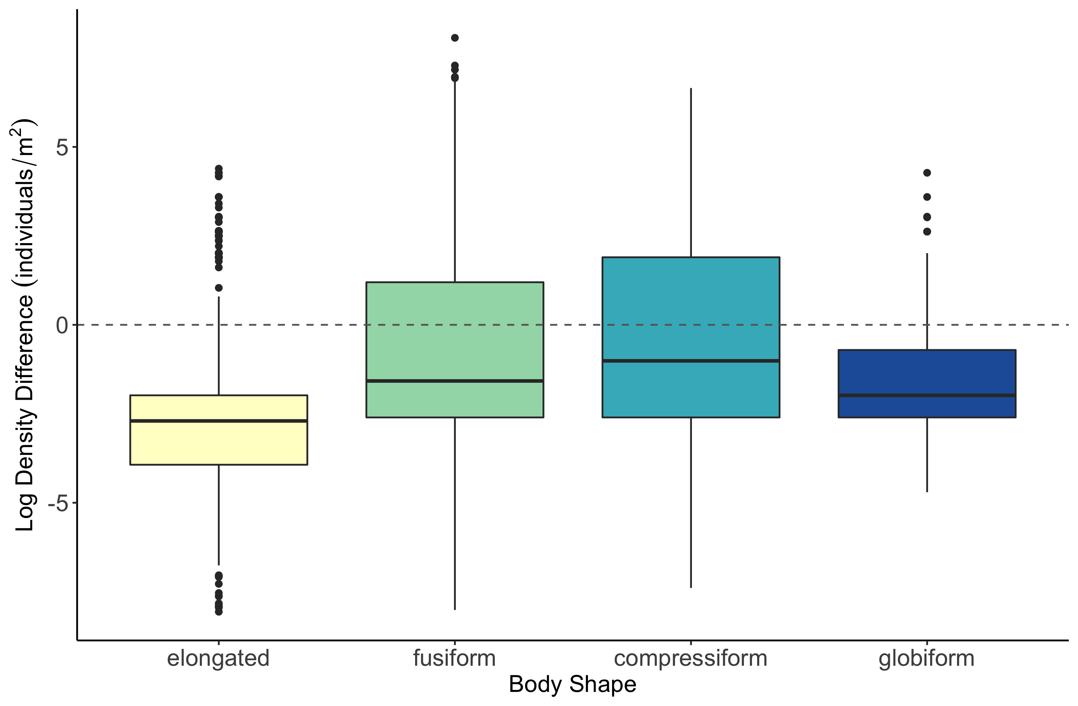
b
c
a
d

Slide 17
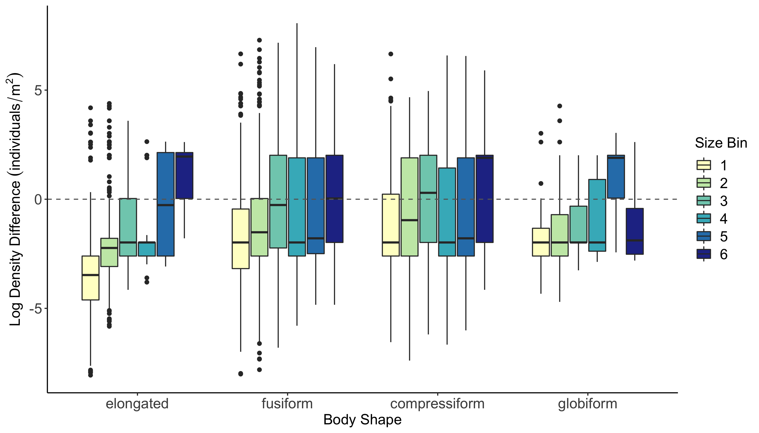

Slide 18
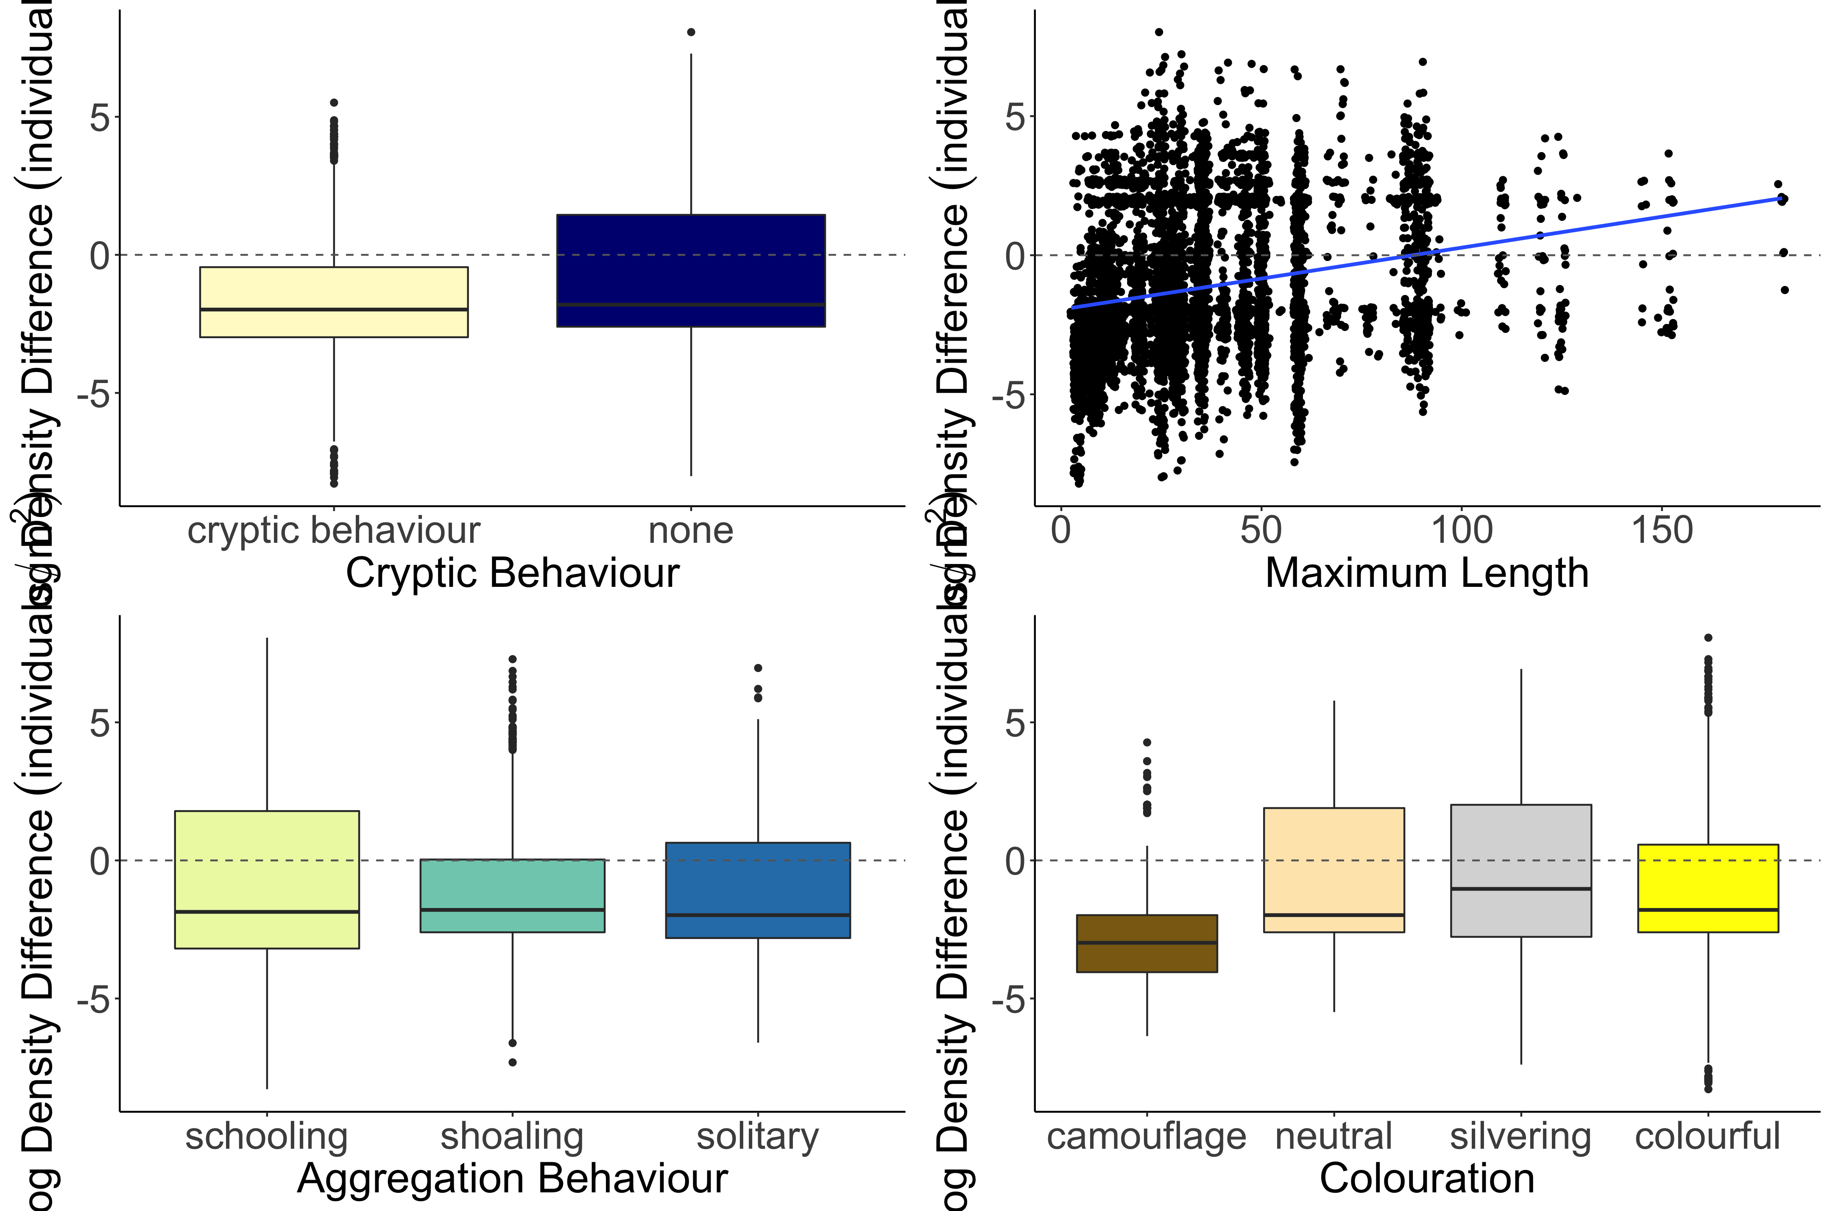
b
Estimate = 0.006355
z value = 3.801
p-value = 0.000144
a
Log Density Difference (individuals/m²)
c
b
b
a

Slide 19
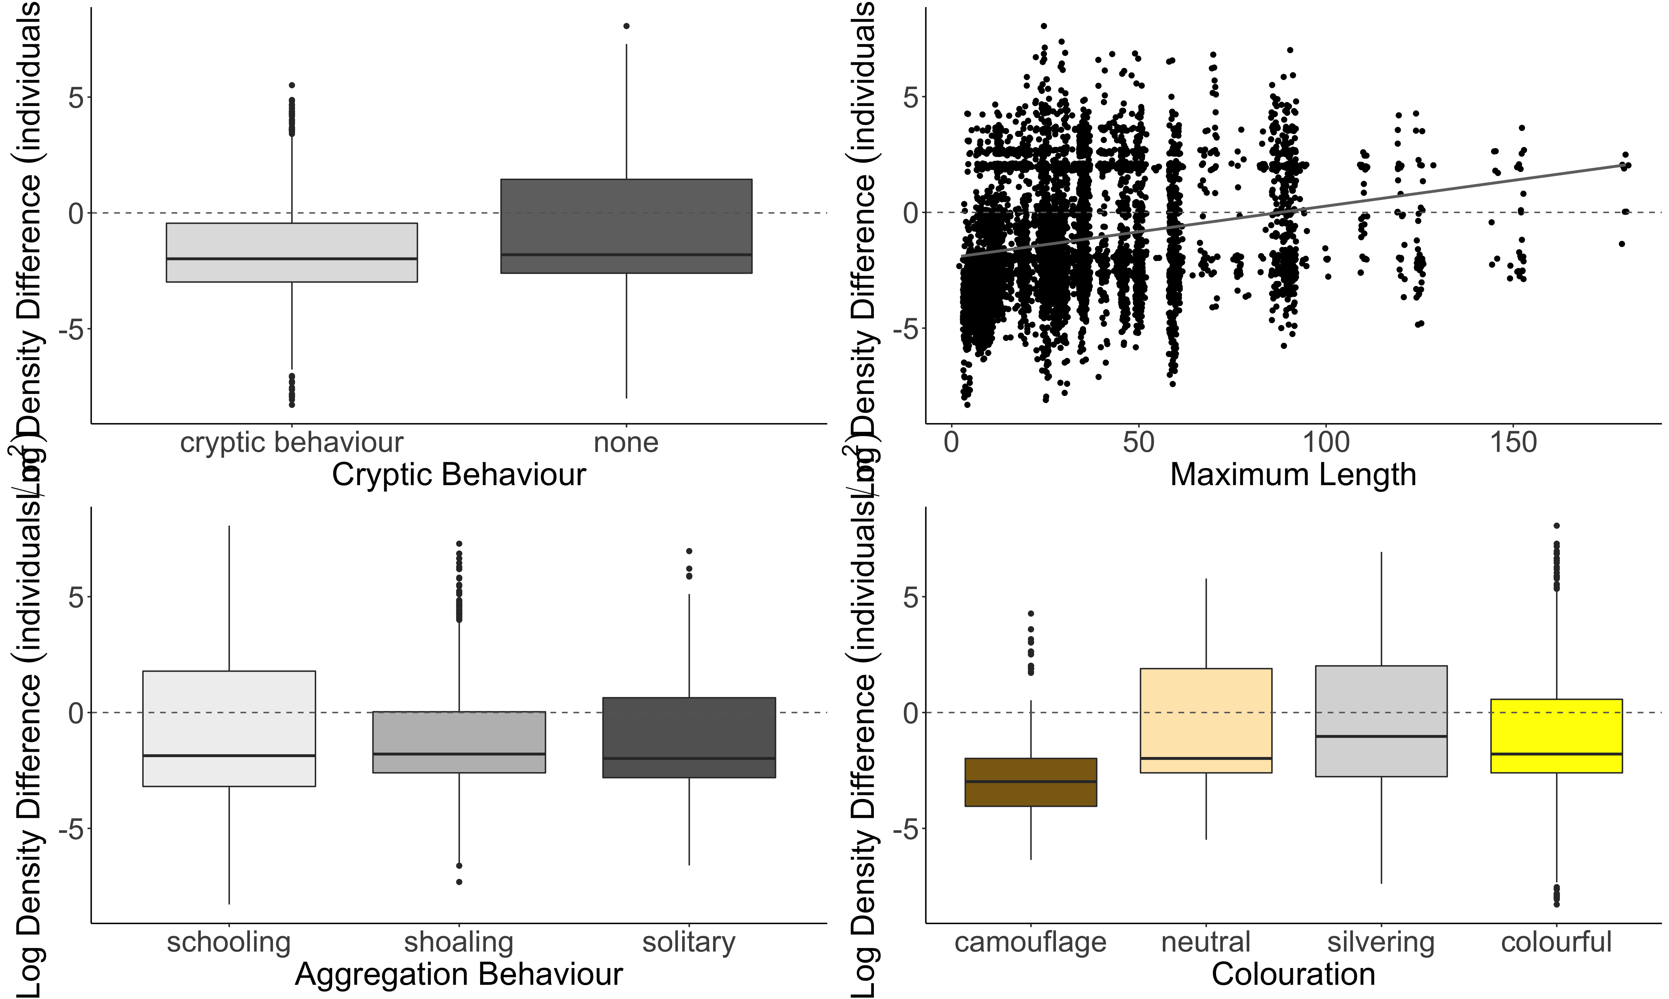
A.
b
B.
Estimate = 0.006355
z value = 3.801
p-value = 0.000144
a
C.
D.
Log Density Difference (individuals/m²)
a
a
b
b
b
b
a

Slide 20
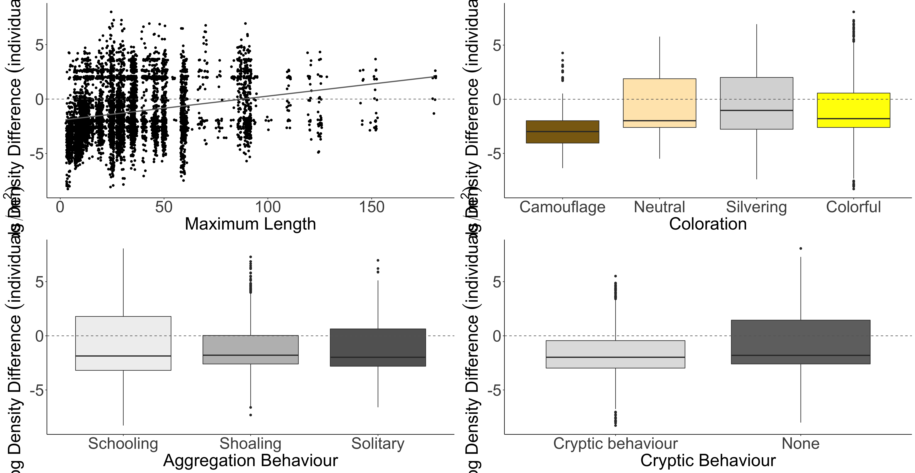
A.
B.
b
b
SVC
Density Greater
b
SVC
Density Greater
a
Belt Transect Density Greater
Belt Transect Density Greater
Log Density Difference (individuals/m²)
C.
a
D.
a
b
b
SVC
Density Greater
a
SVC
Density Greater
Belt Transect Density Greater
Belt Transect Density Greater

Slide 21
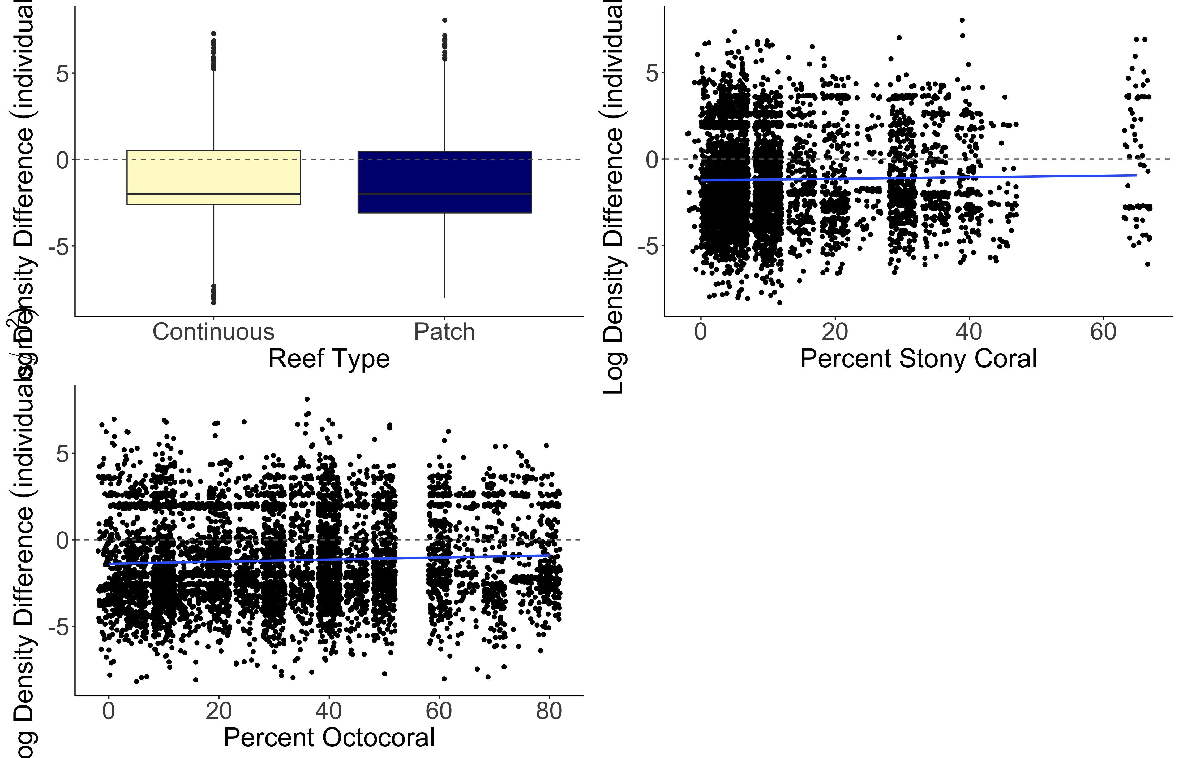
a
b
Estimate = 0.015630
z value = 4.570
p-value = 4.9e-06
Log Density Difference (individuals/m²)
Estimate = 0.009786
z value = 6.254
p-value = < 2e-16

Slide 22
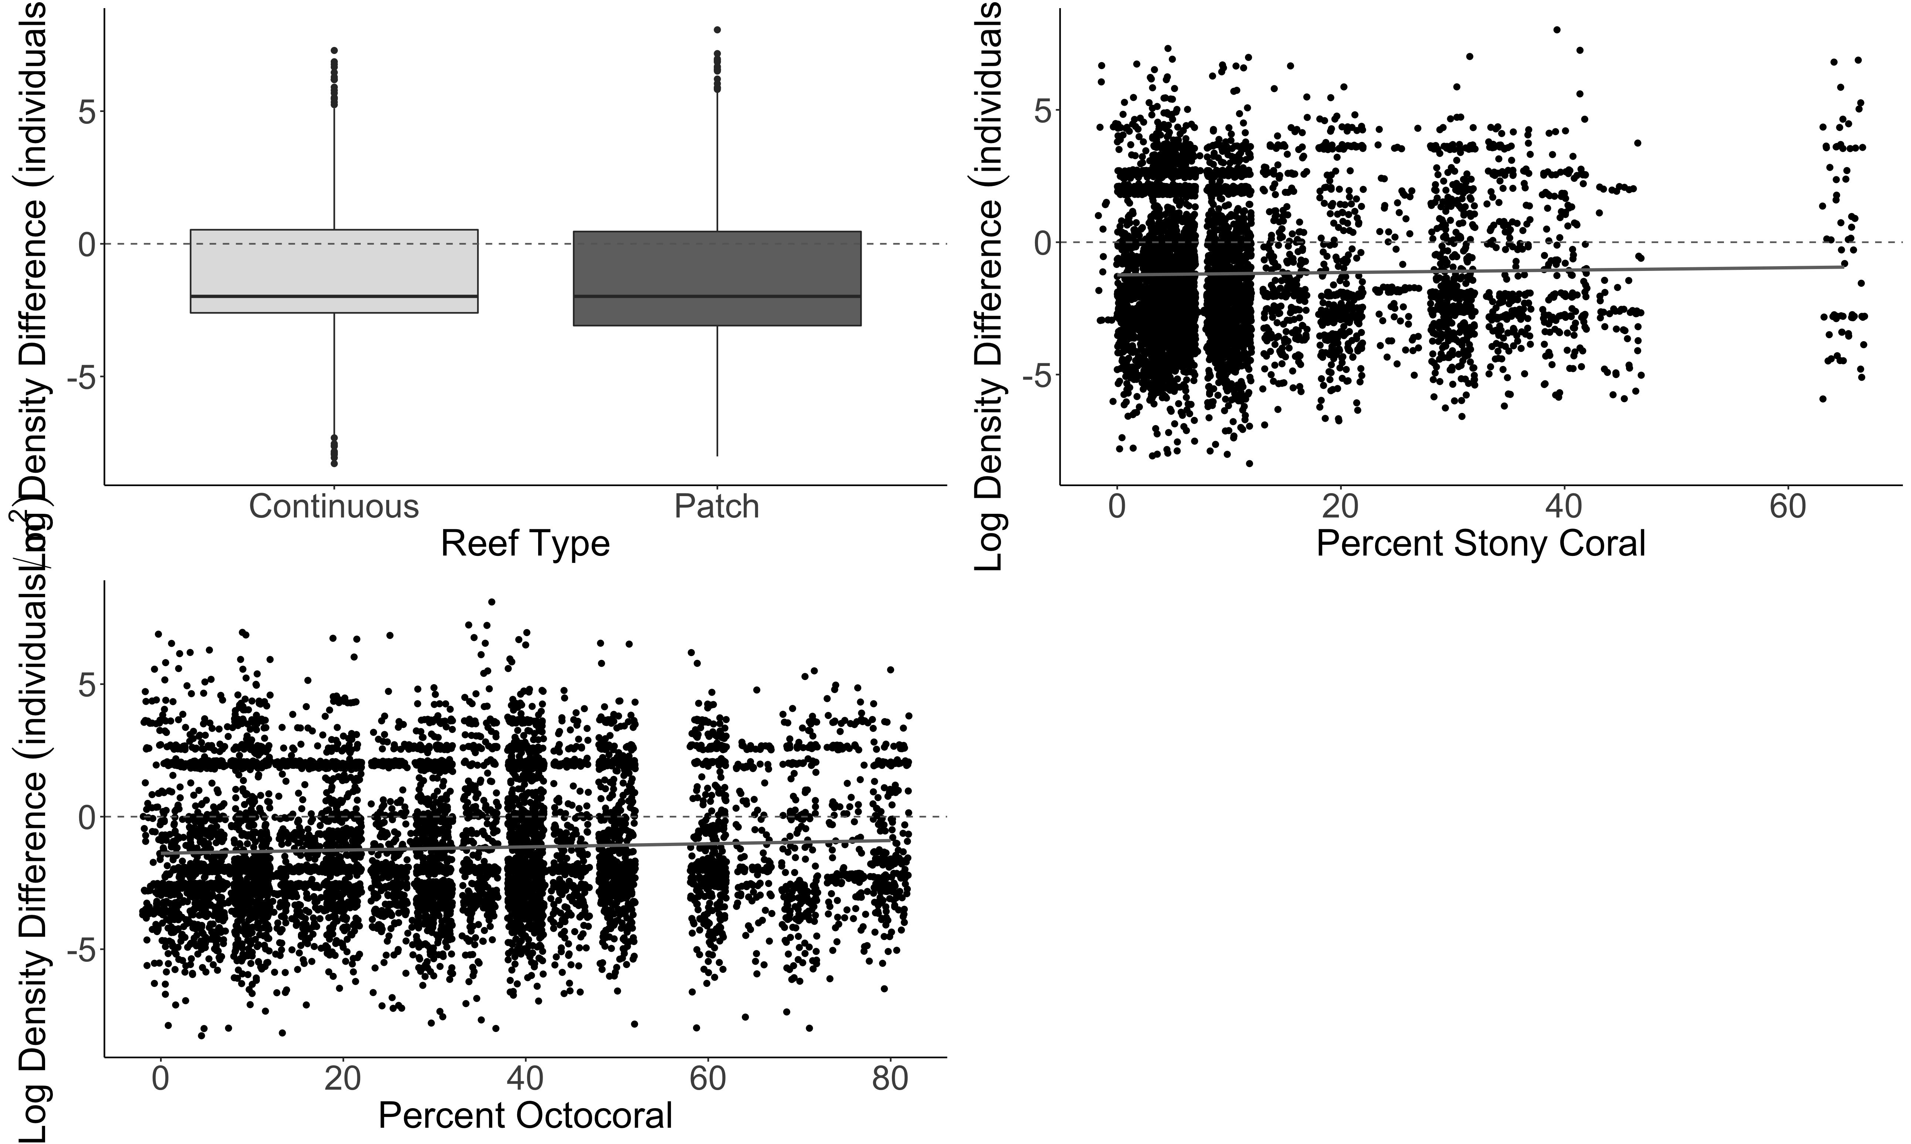
A.
B.
a
b
Estimate = 0.015630
z value = 4.570
p-value = 4.9e-06
Log Density Difference (individuals/m²)
C.
Estimate = 0.009786
z value = 6.254
p-value = < 2e-16

Slide 23
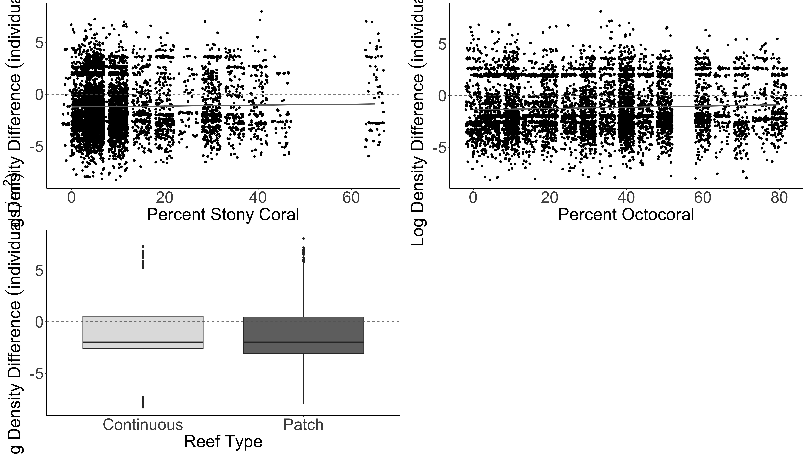
Estimate = 0.015630
z value = 4.570
p-value = 4.9e-06
Estimate = 0.009786
z value = 6.254
p-value = < 2e-16
A.
B.
Log Density Difference (individuals/m²)
C.
a
b

Slide 24
A.
B.
SVC
Density Greater
SVC
Density Greater
Belt Transect Density Greater
Belt Transect Density Greater
Log Density Difference (individuals/m²)
C.
a
b
SVC
Density Greater
Belt Transect Density Greater

Slide 25
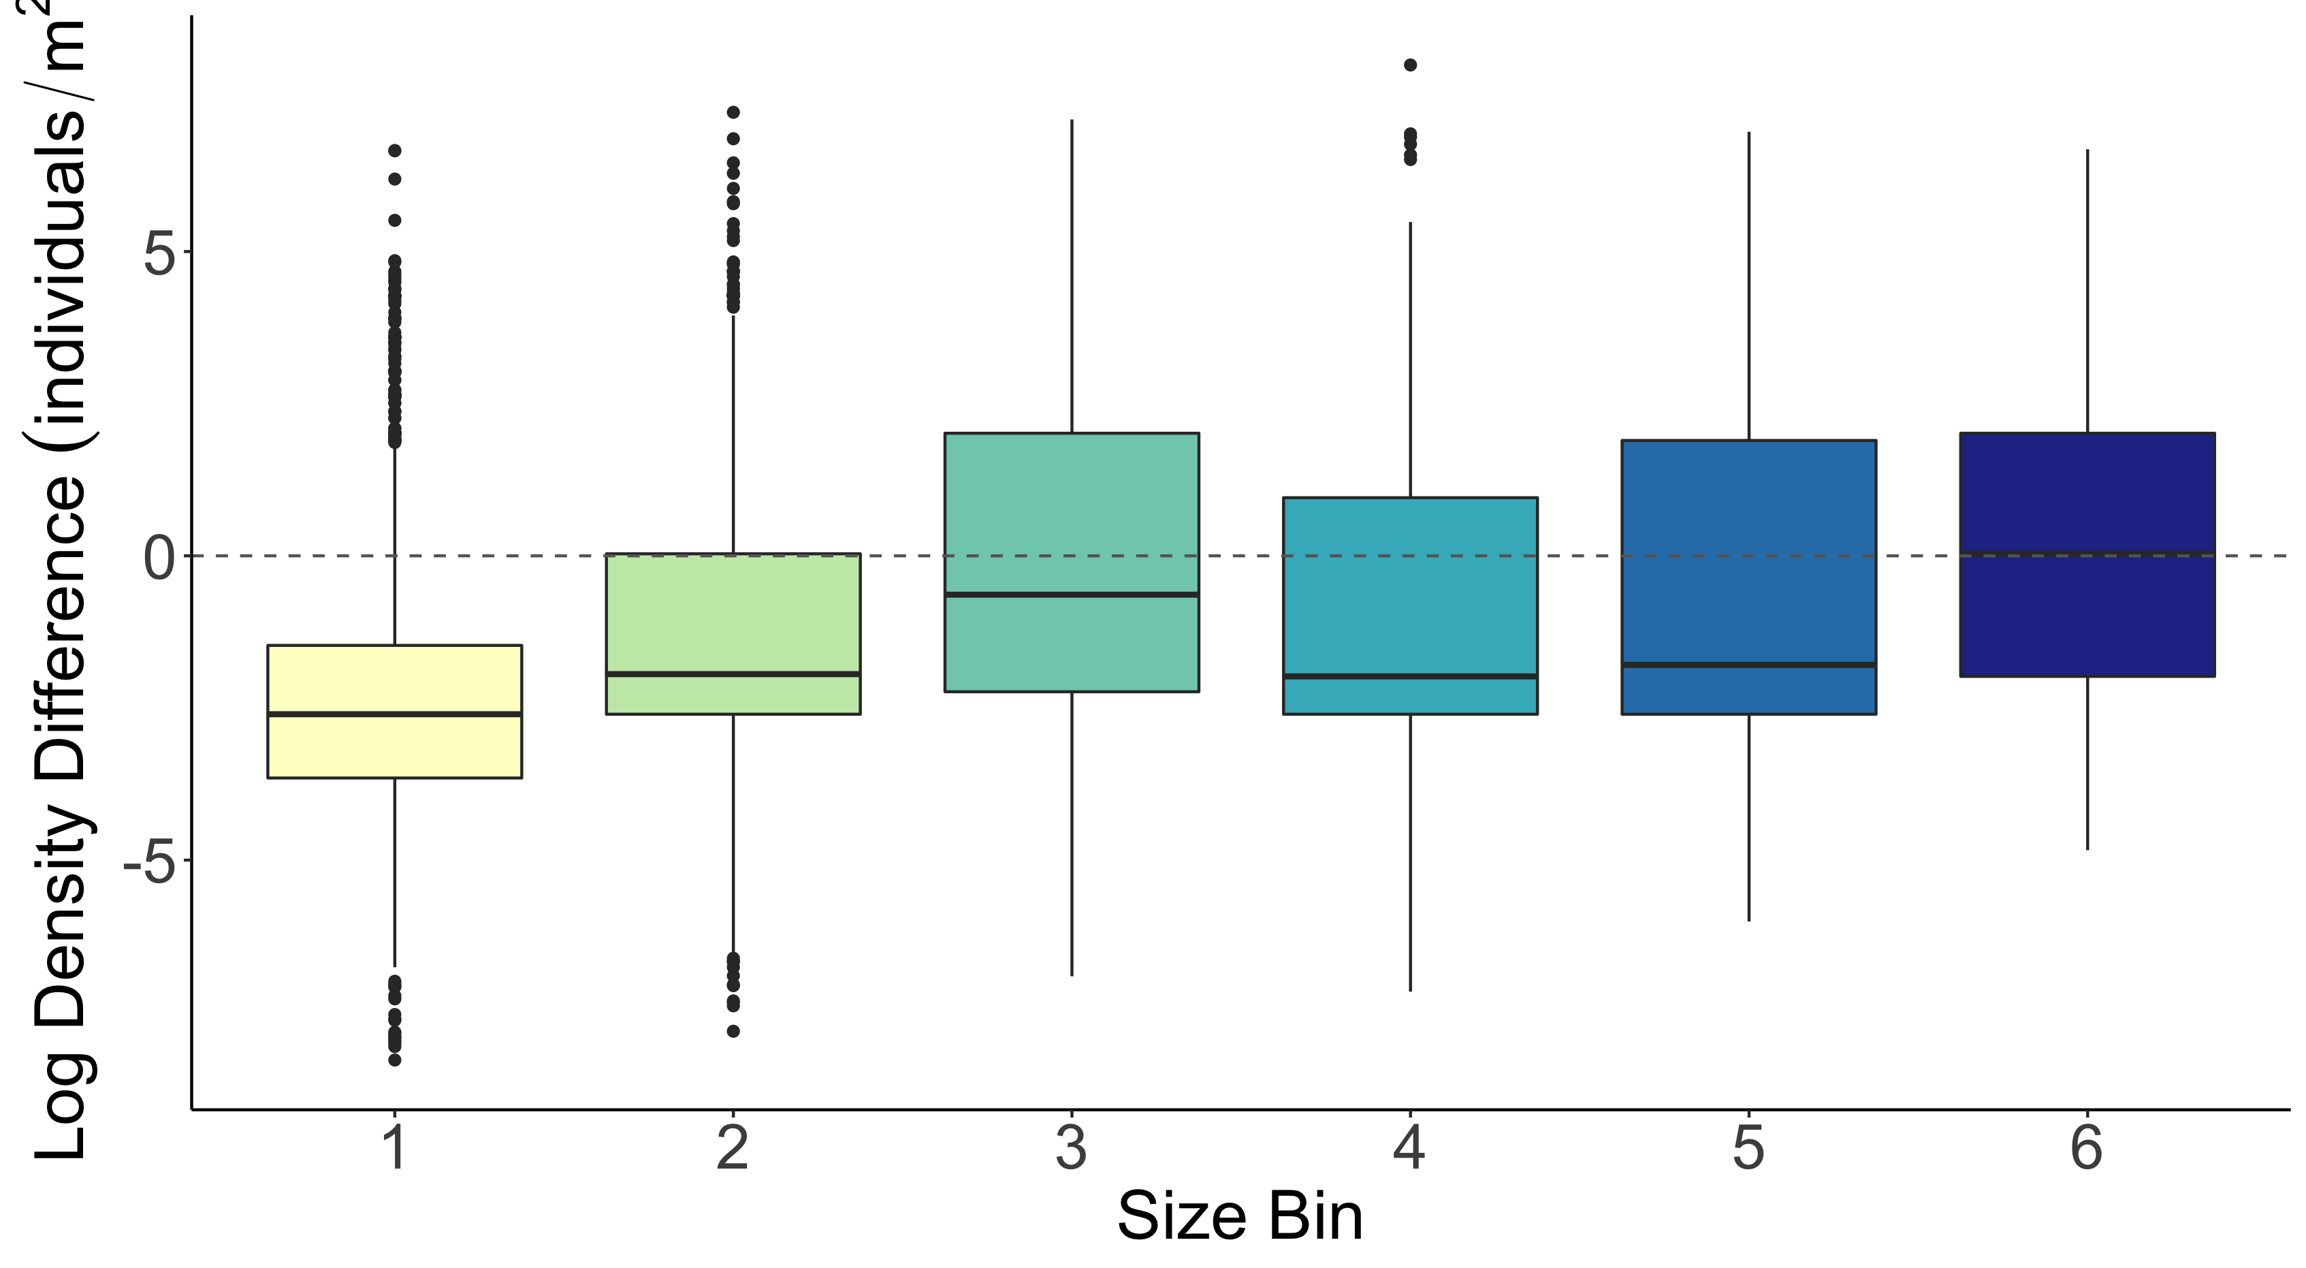
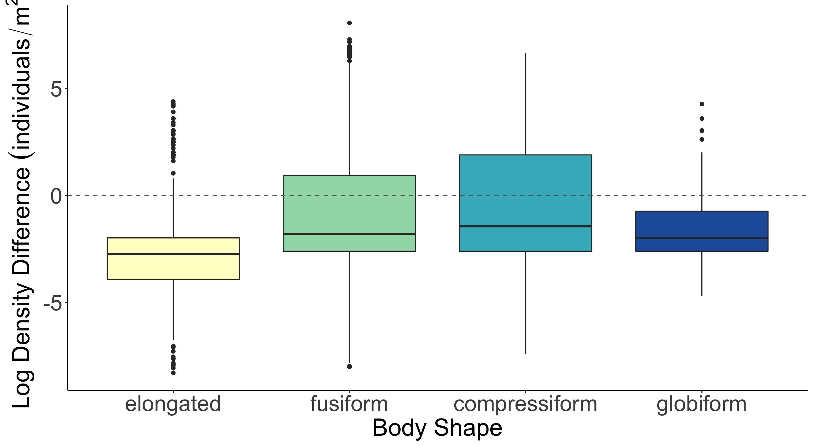
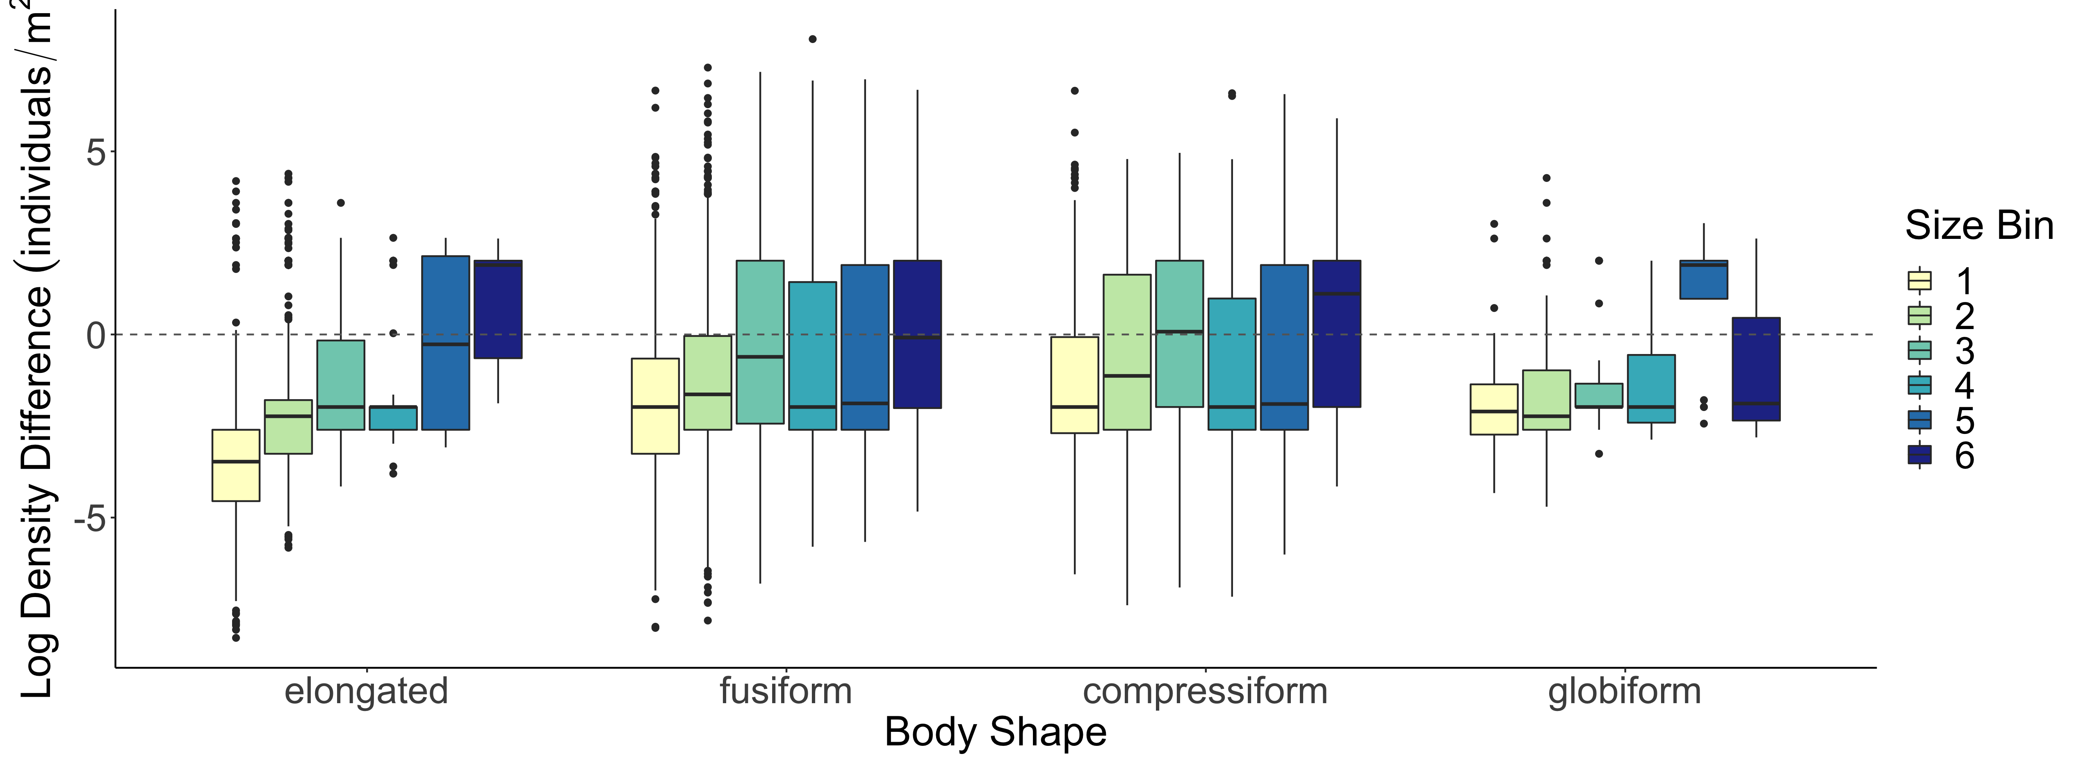
b
b
a
b
c
d
c
c
a
d
b
c
Log Density Difference (individuals/m²)
a
d

Slide 26
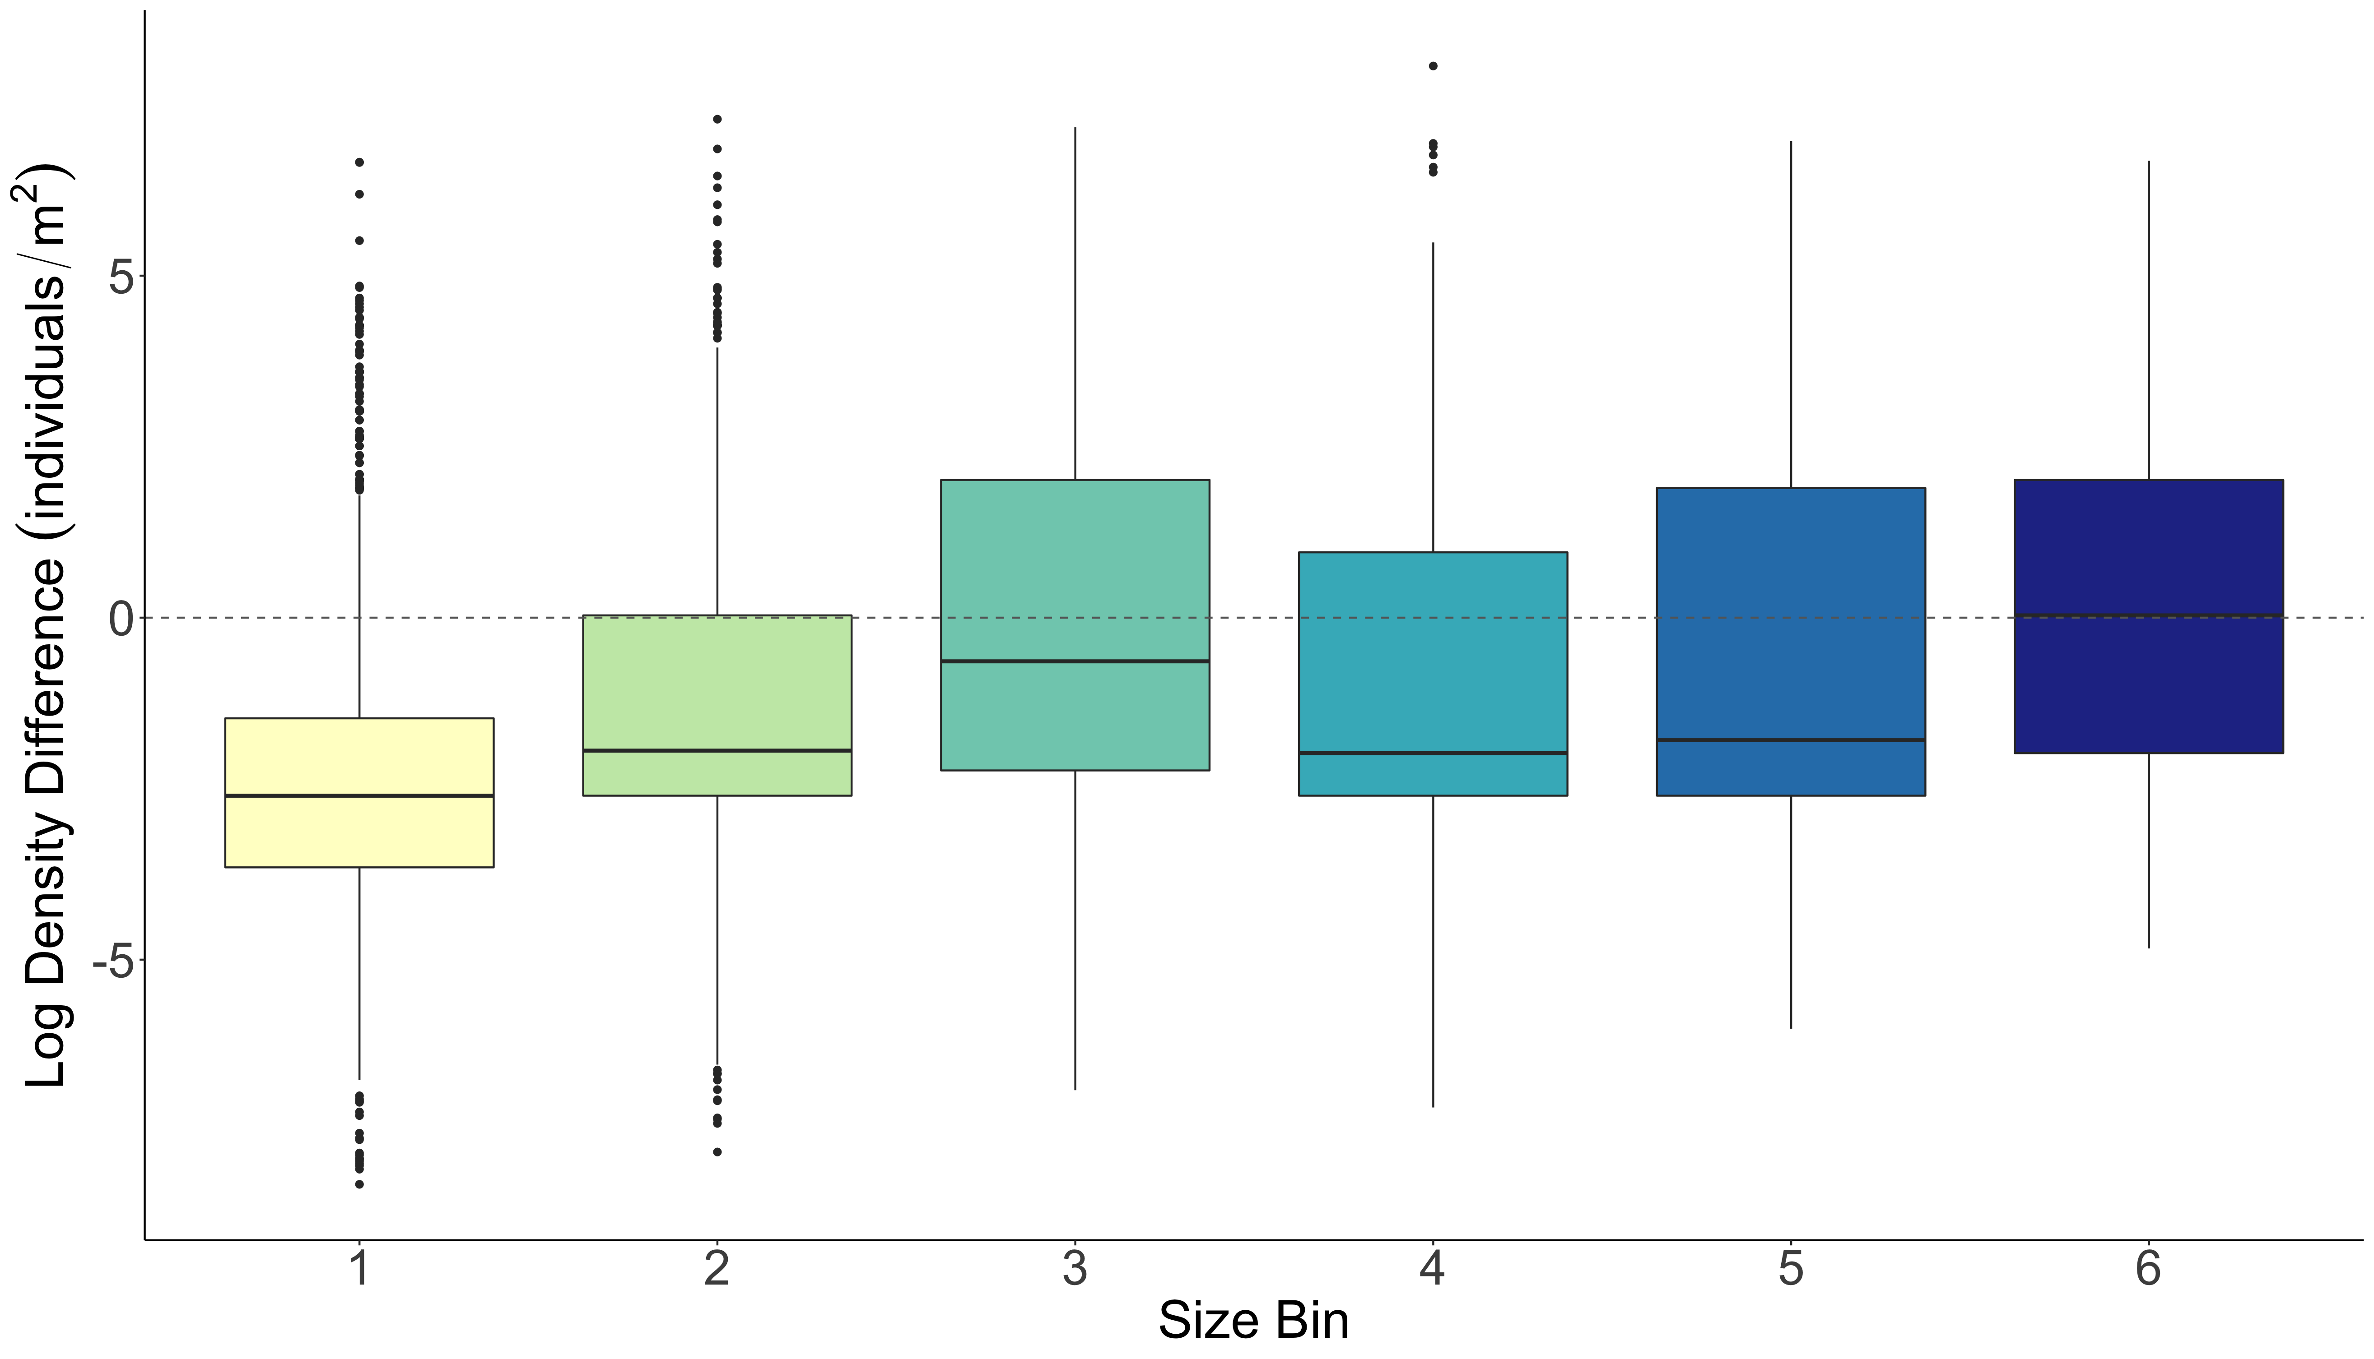
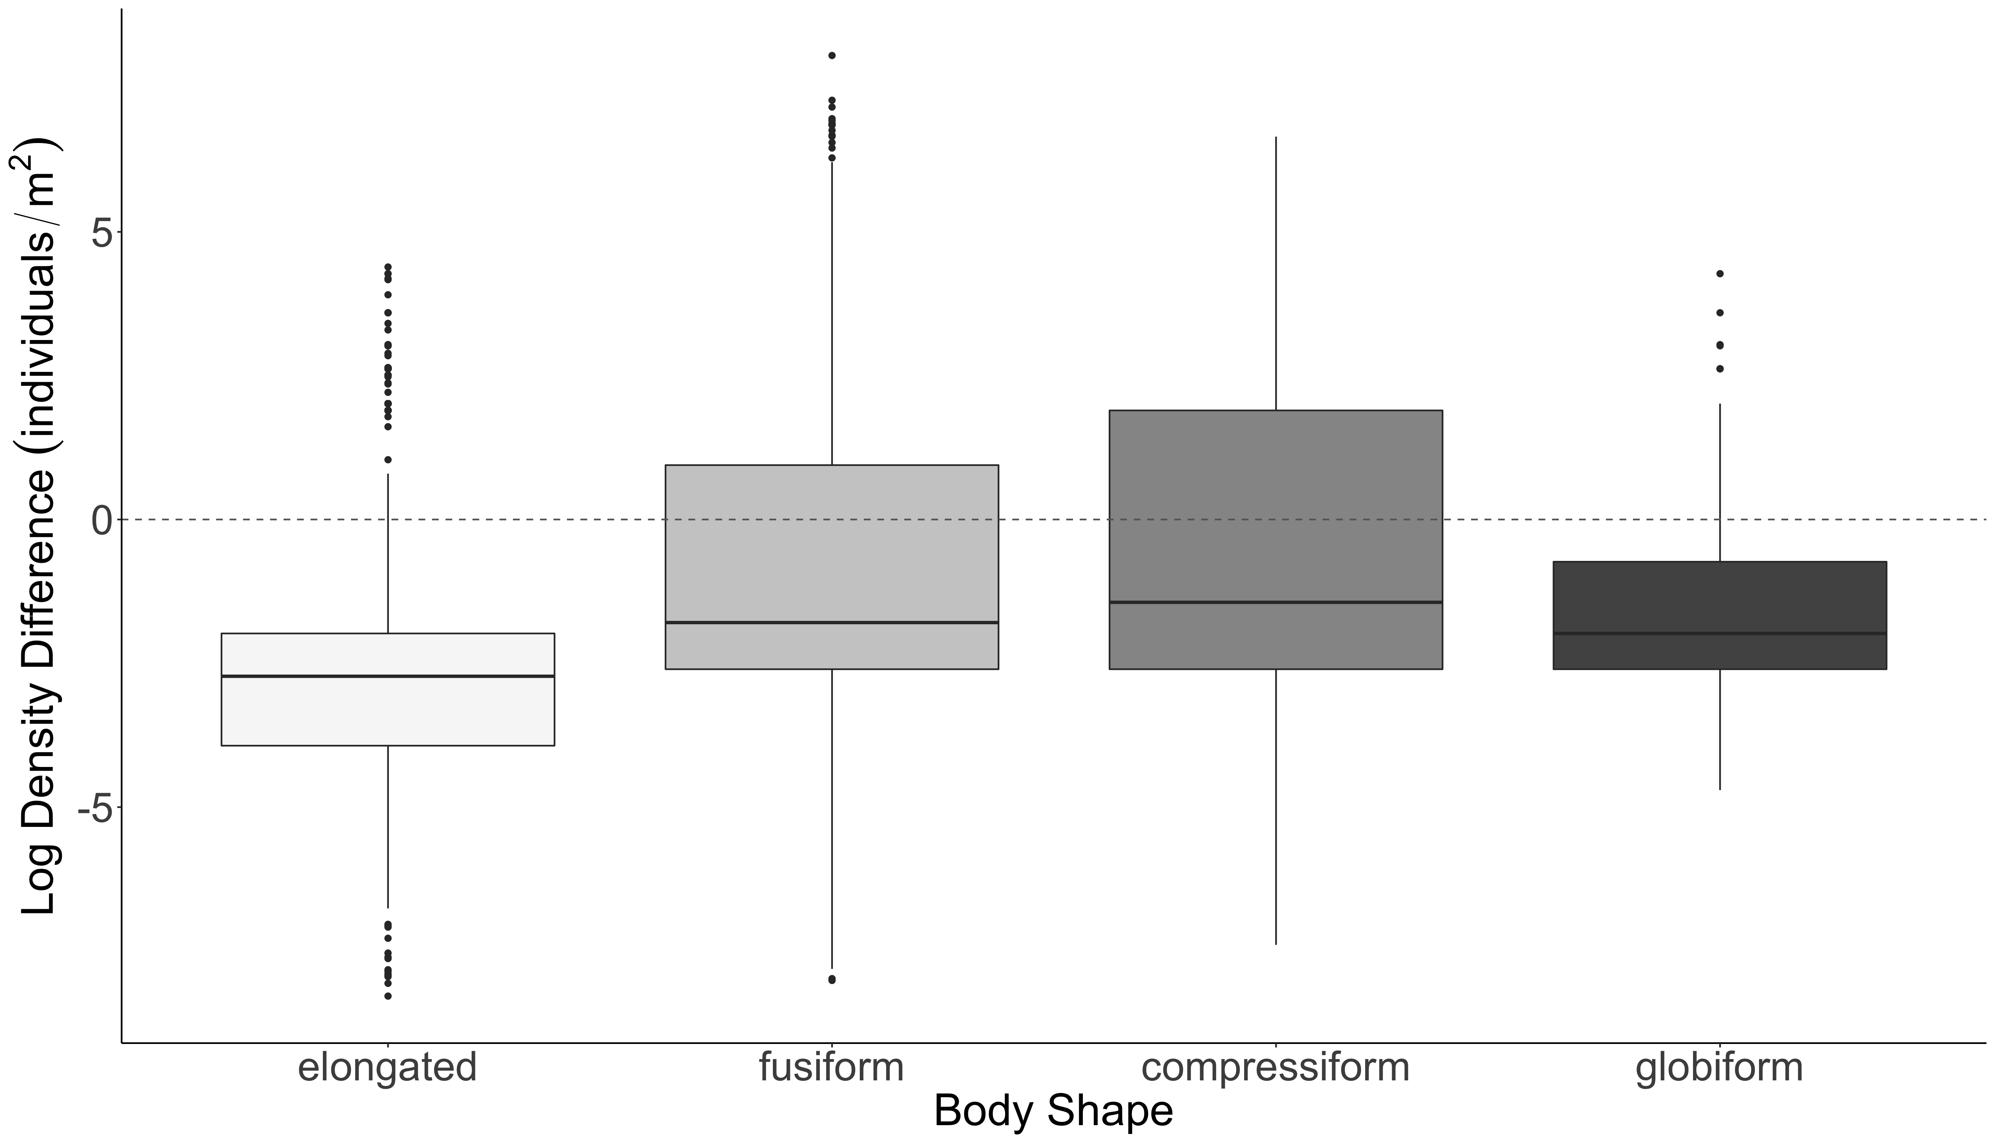
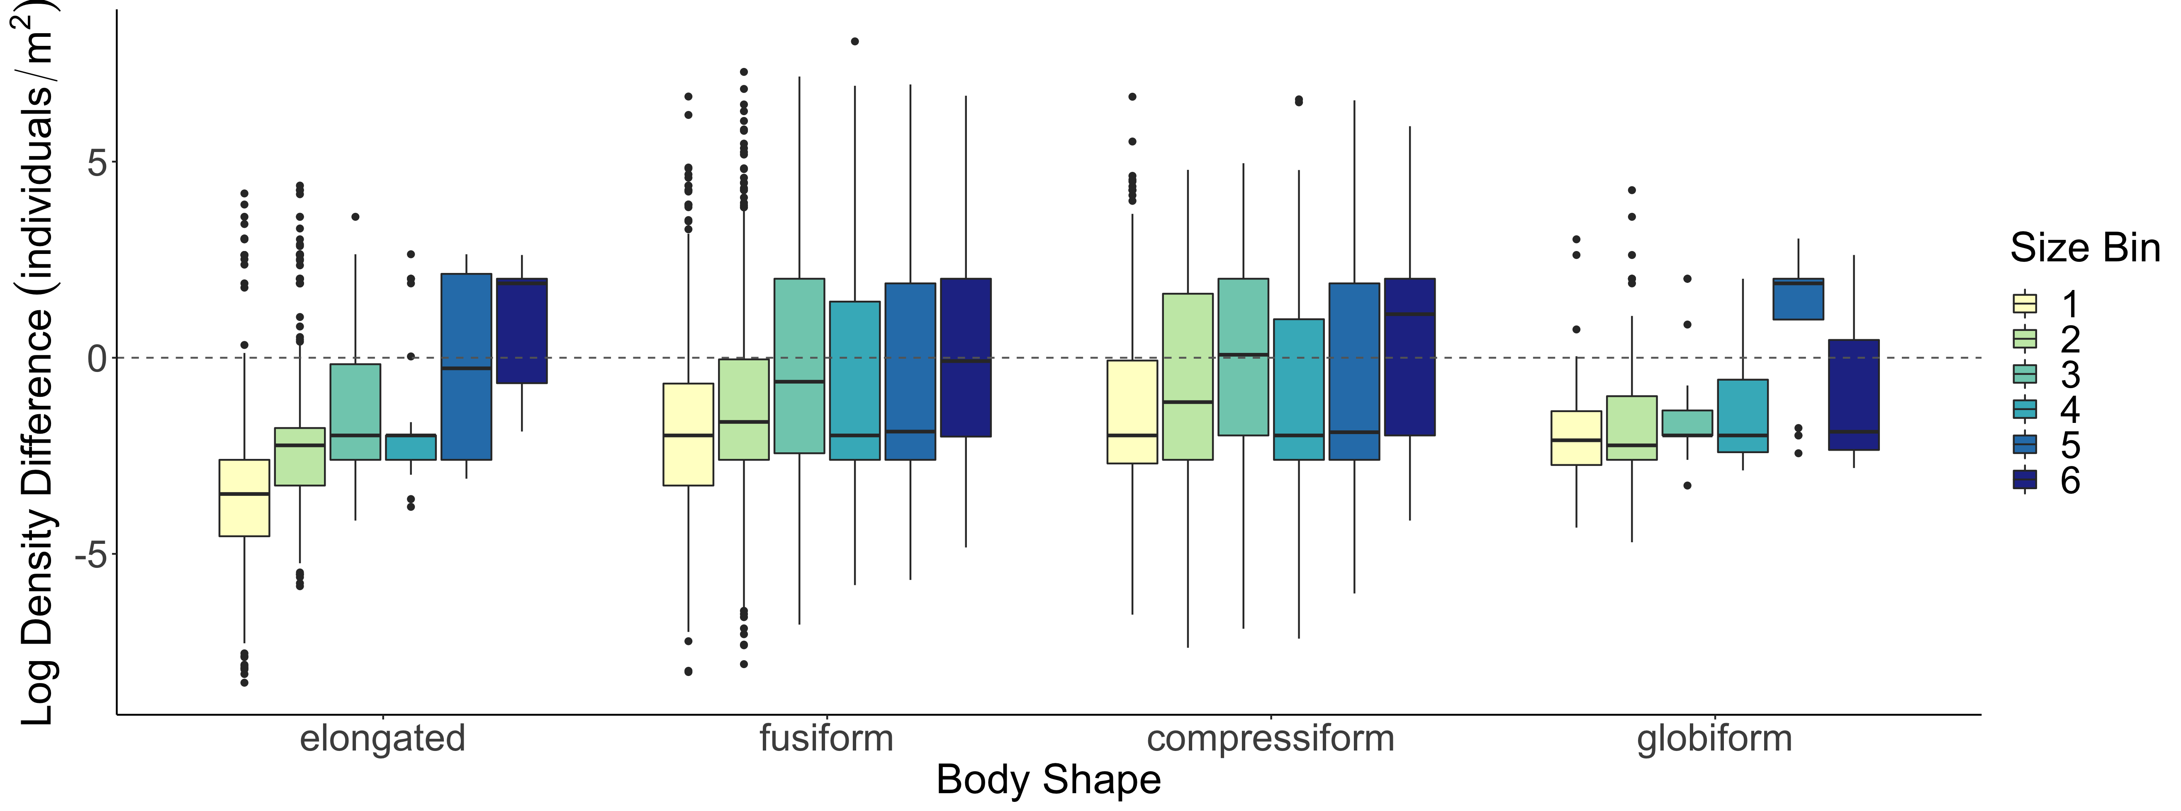
A.
b
c
b
B.
b
a
c
bc
b
a
ab
C.
Log Density Difference (individuals/m²)

Slide 27
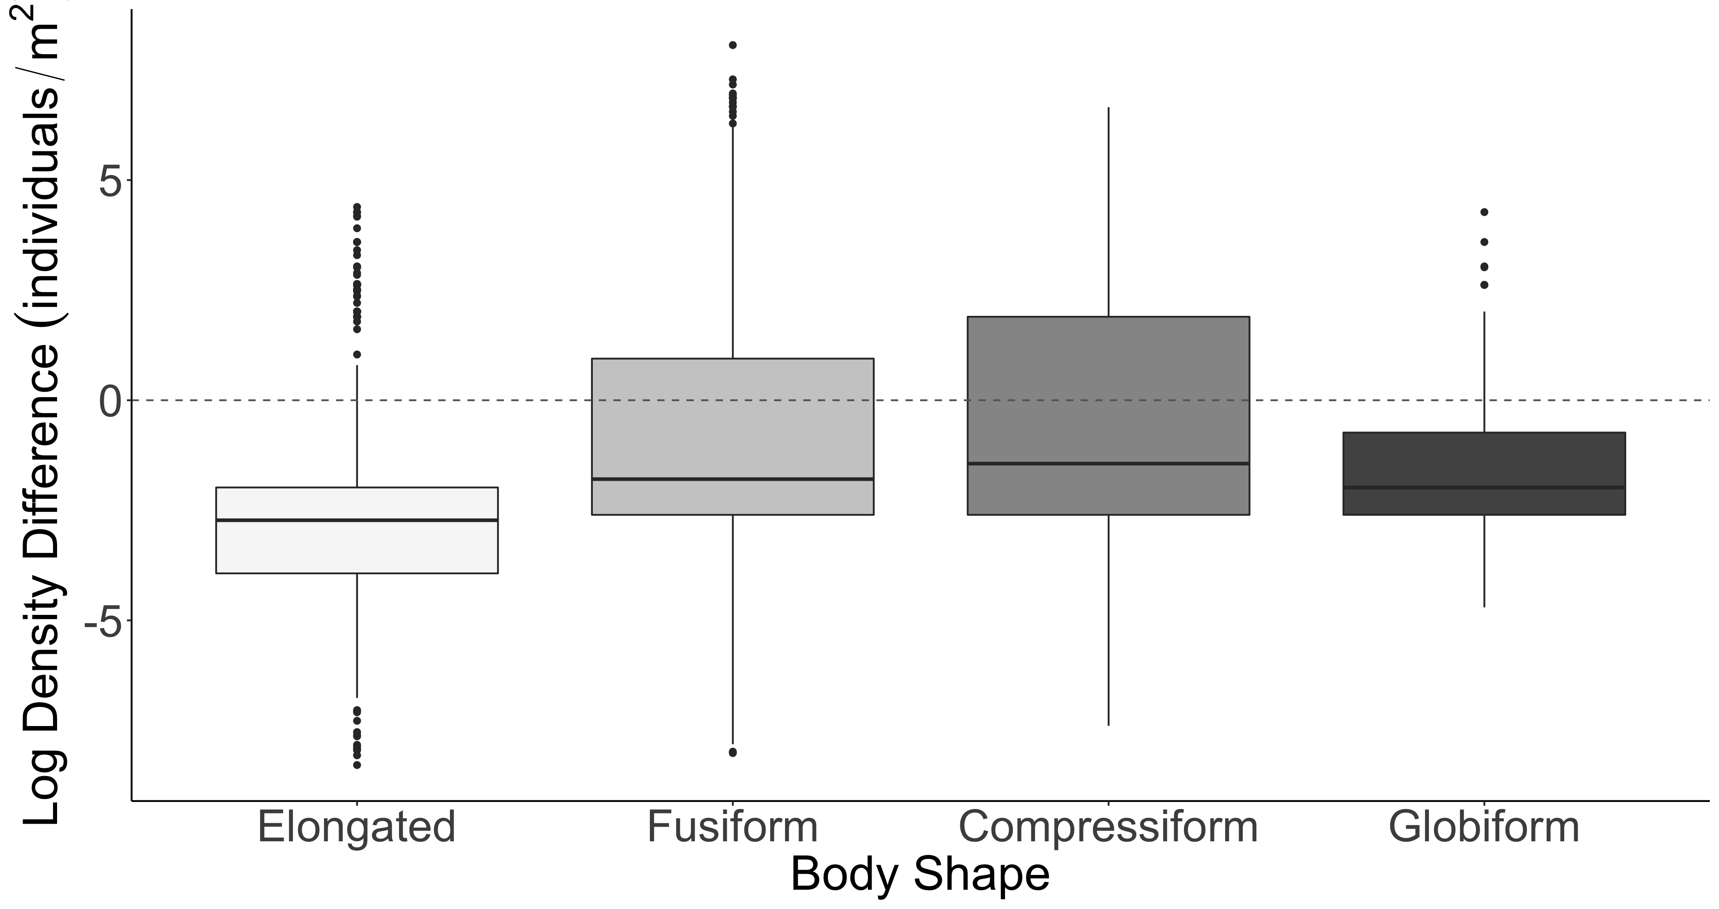
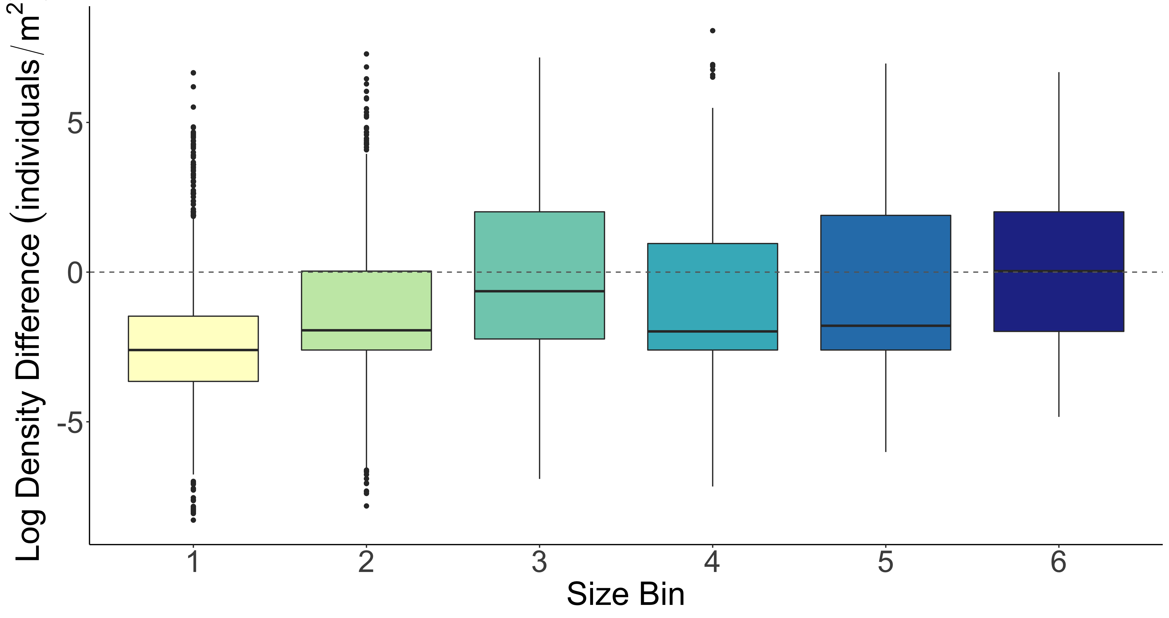
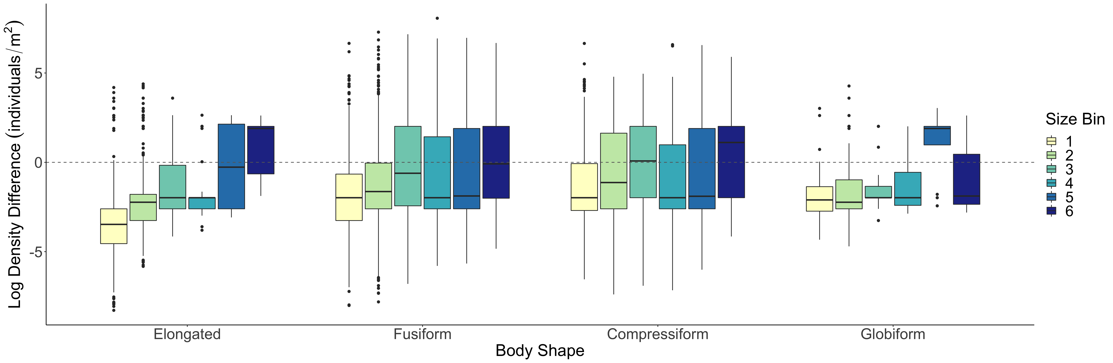
A.
b
B.
b
b
b
a
c
c
bc
a
ab
C.
Log Density Difference (individuals/m²)

Slide 28
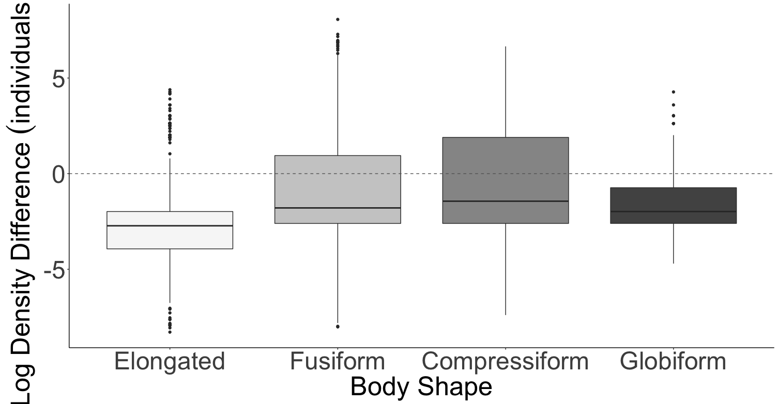
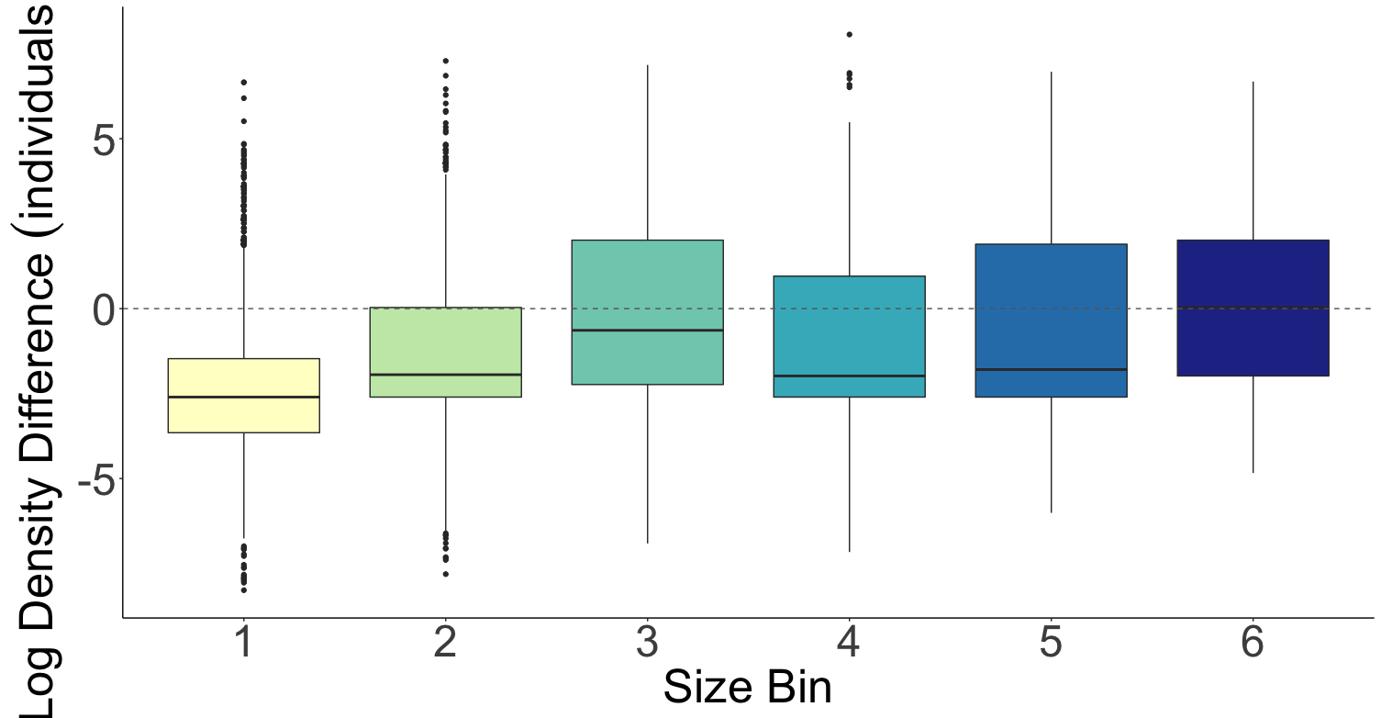
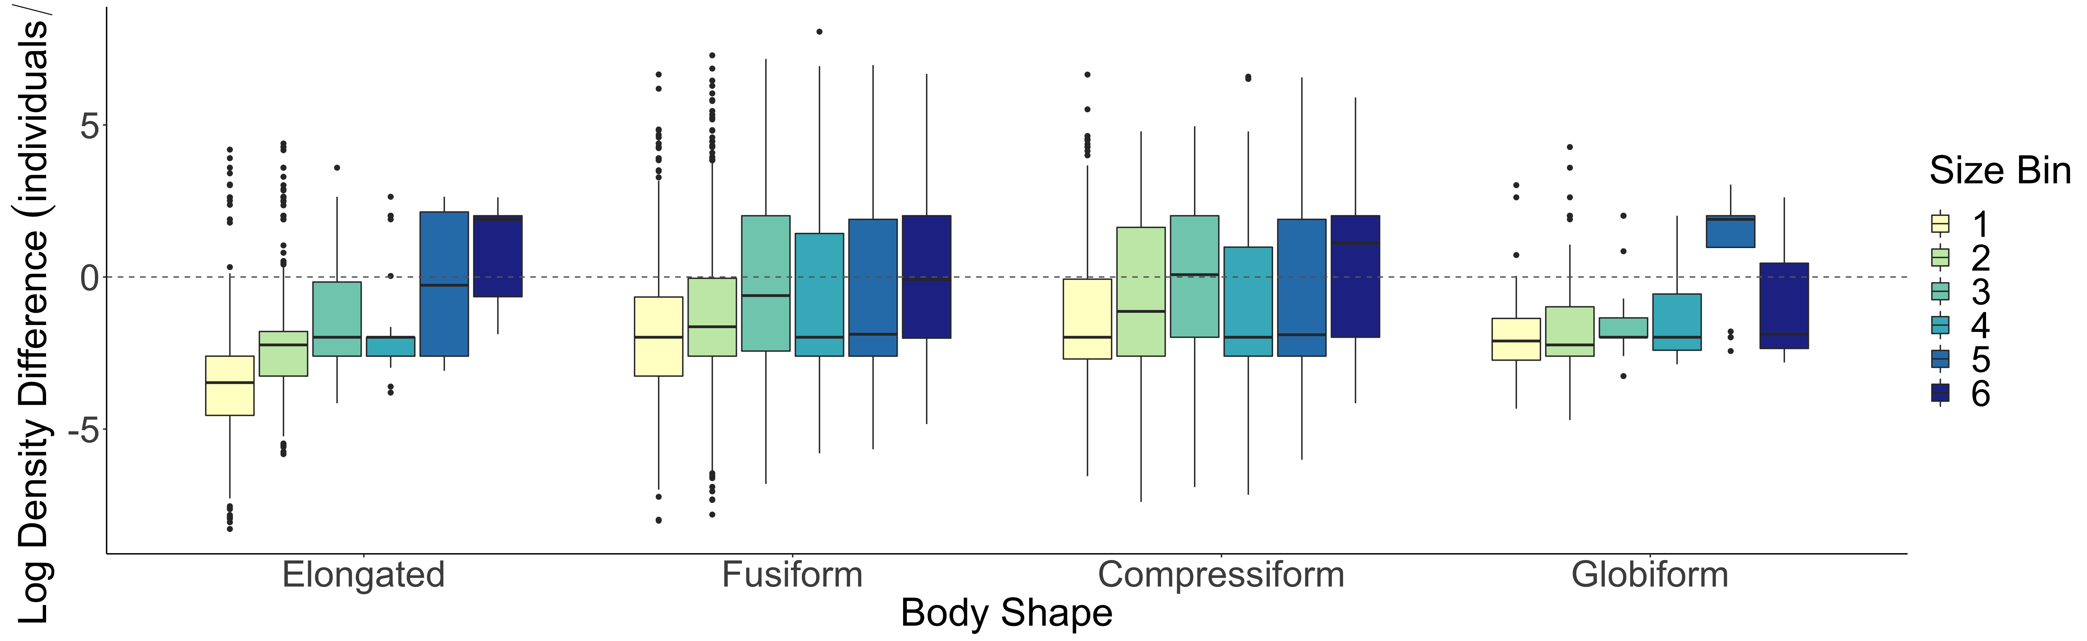
A.
b
B.
b
b
b
a
c
c
bc
a
ab
Log Density Difference (individuals/m²)
C.

Slide 29
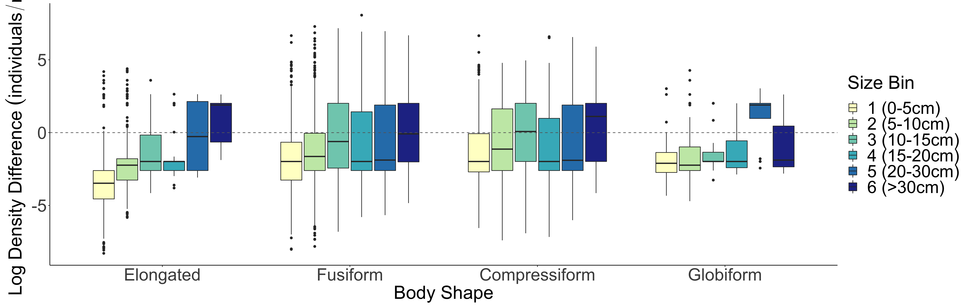
A.
b
B.
b
b
a
b
c
c
bc
a
ab
C.
Log Density Difference (individuals/m²)

Slide 30

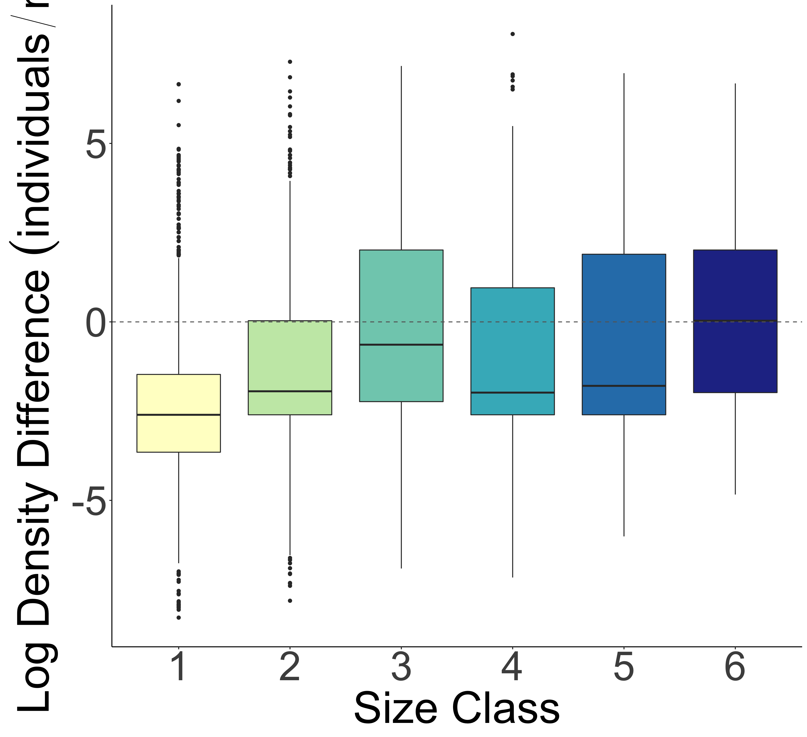
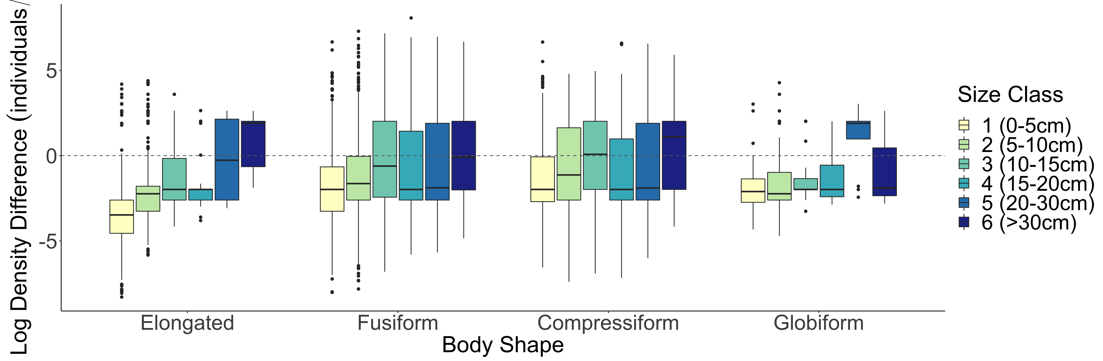
A.
b
B.
b
b
a
b
c
c
bc
a
ab
SVC
Density Greater
SVC
Density Greater
Belt Transect Density Greater
Belt Transect Density Greater
Log Density Difference (individuals/m²)
C.
SVC
Density Greater
Belt Transect Density Greater

Slide 31
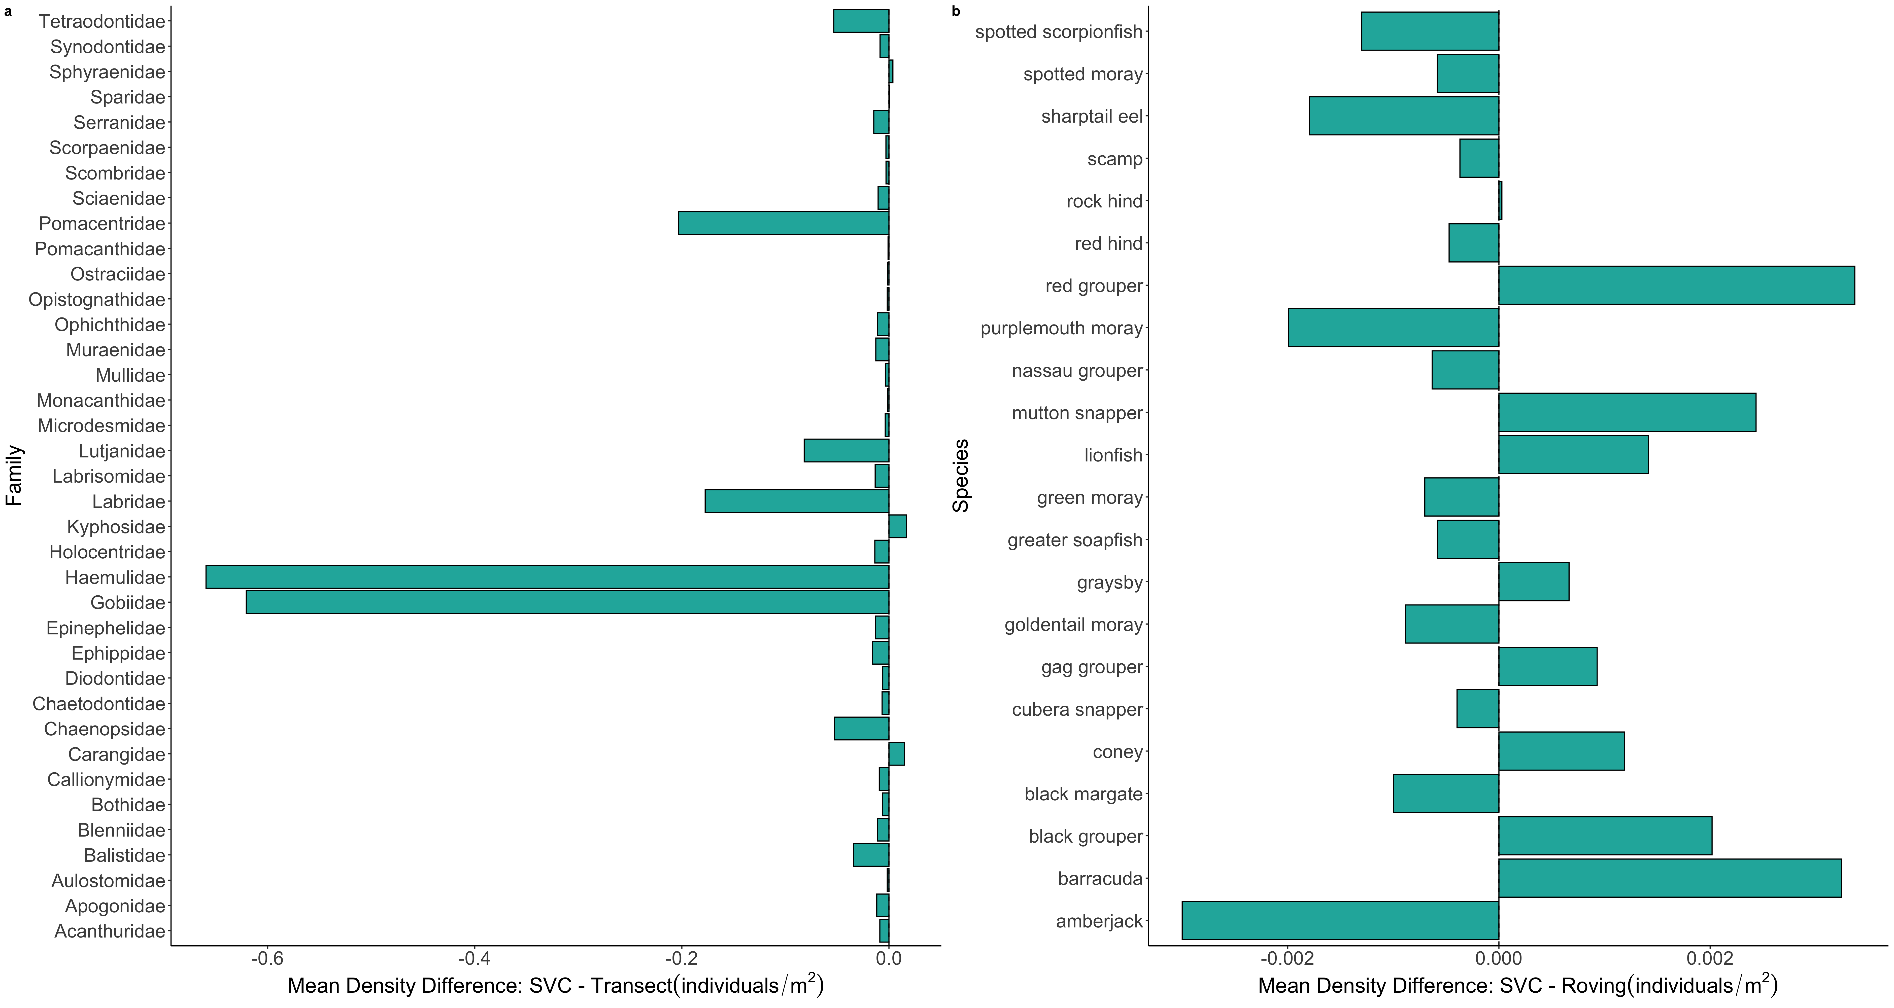
a
b

Slide 32
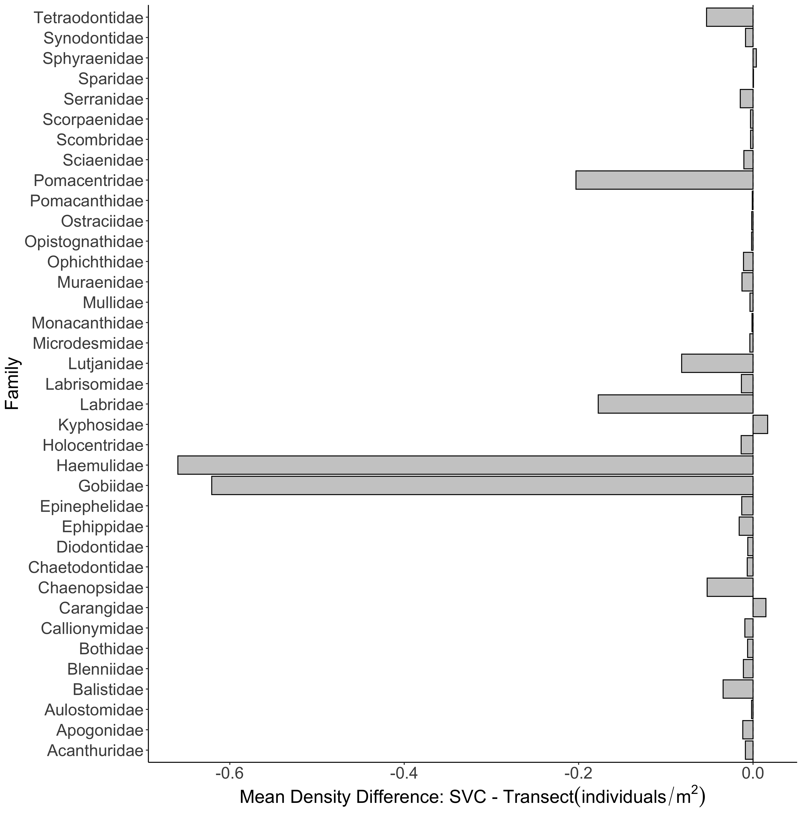
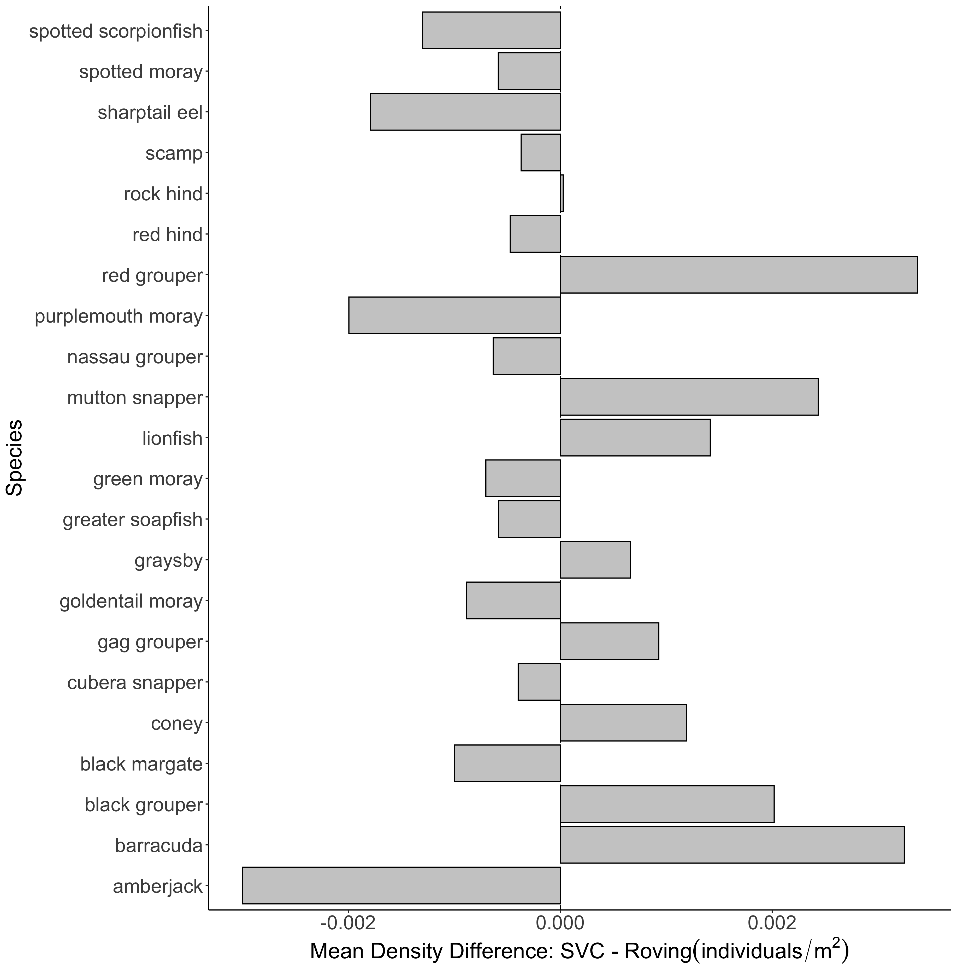
A.
B.

Slide 33
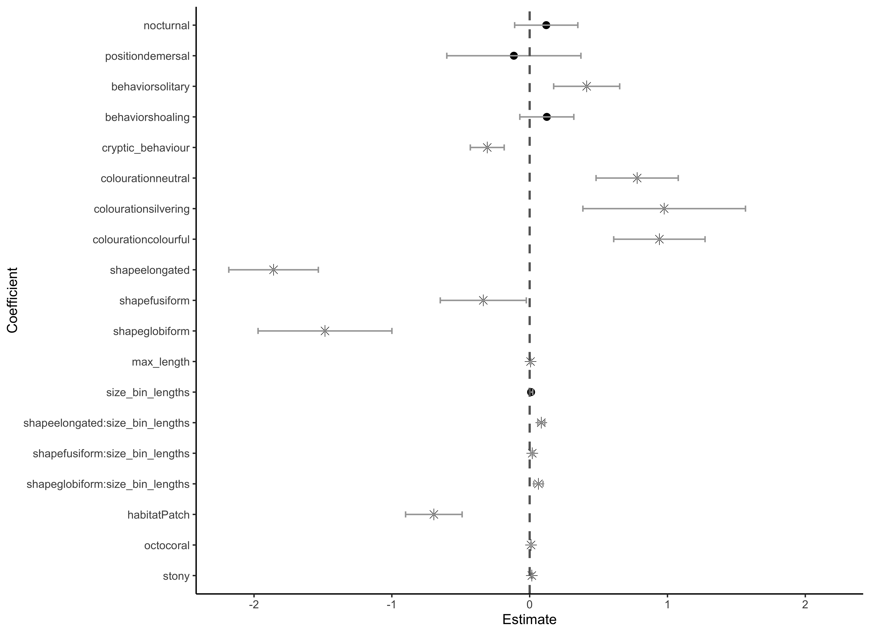
Aggregation
Coloration
Species Traits
Shape
Size*Shape
Habitat Traits

Slide 34
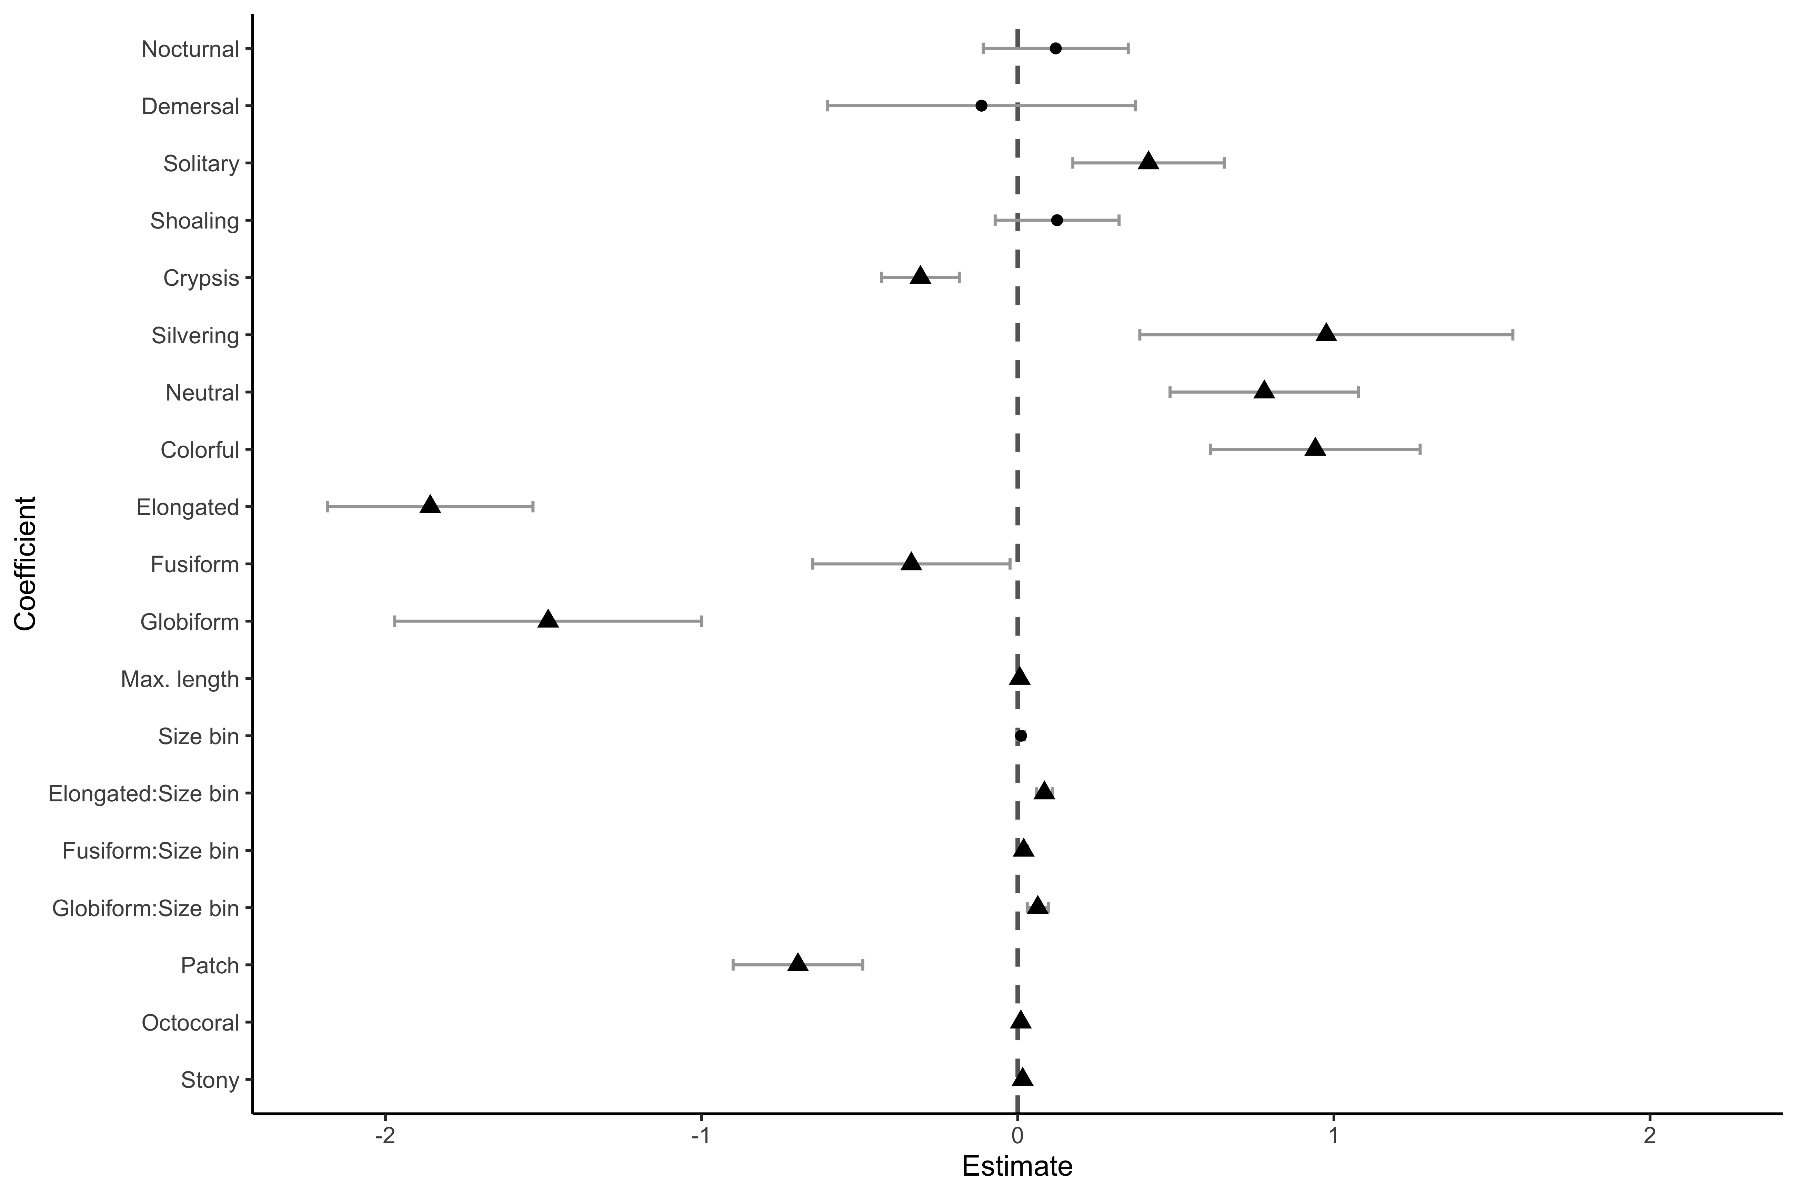
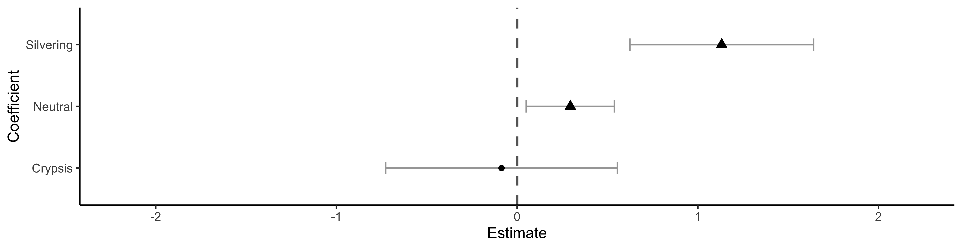
A.
Aggregation
Coloration
Species Traits
Shape
Shape*Size bin
Habitat Traits
B.
Coloration

Slide 35
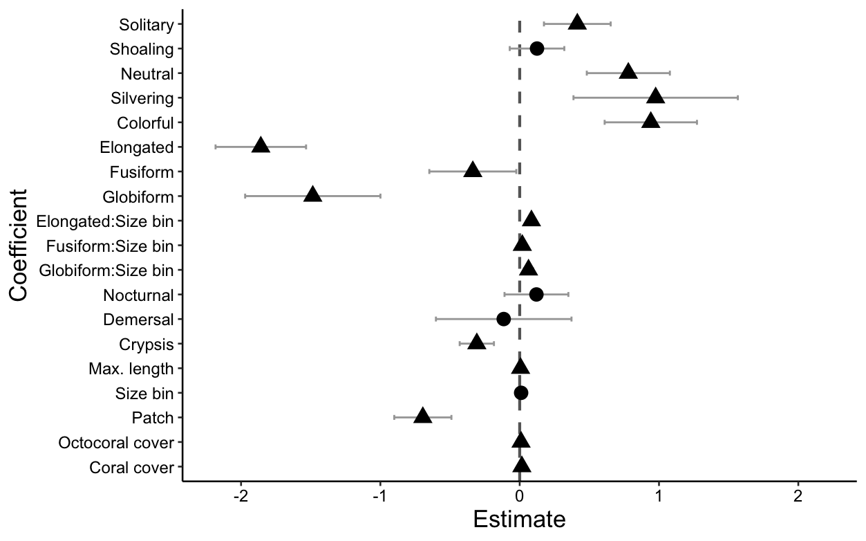
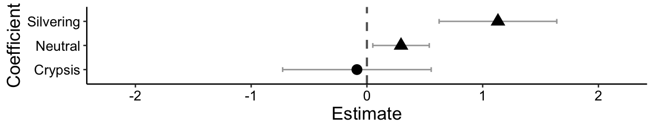
A.
Aggregation
Coloration
Shape
Species Traits
Shape*Size bin
Habitat Traits
B.
Coloration

Slide 36
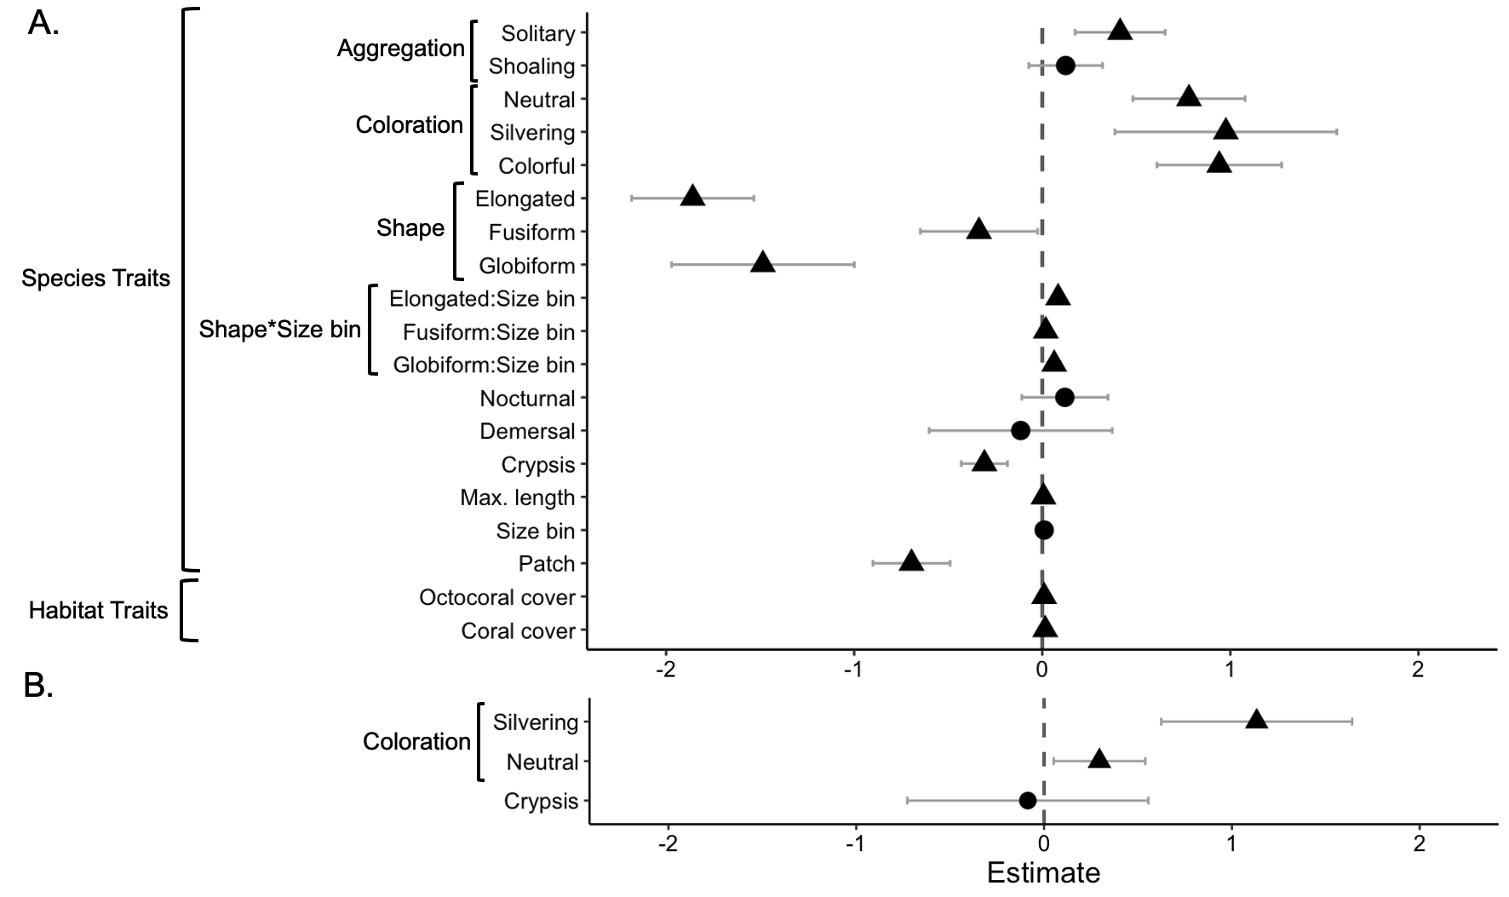
Belt Transect Density Greater
SVC
Density Greater
Roving
Density Greater
SVC
Density Greater

Slide 37
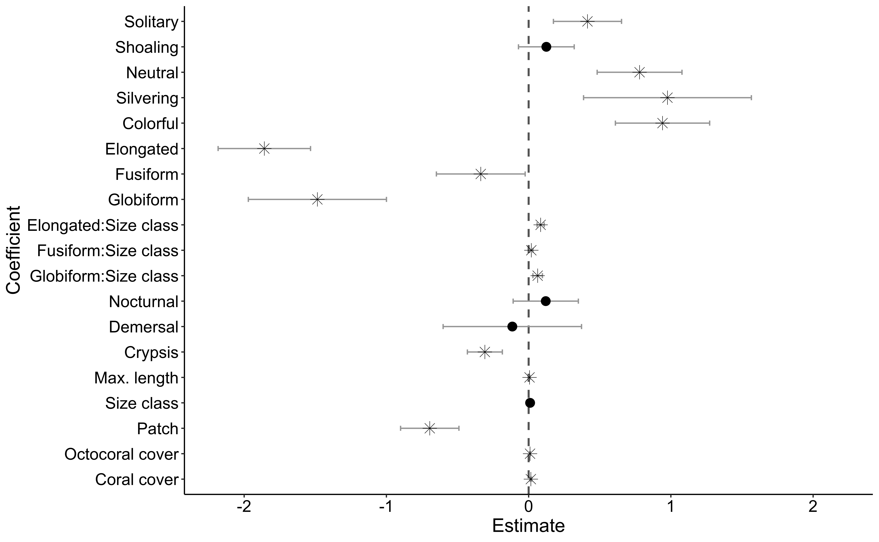
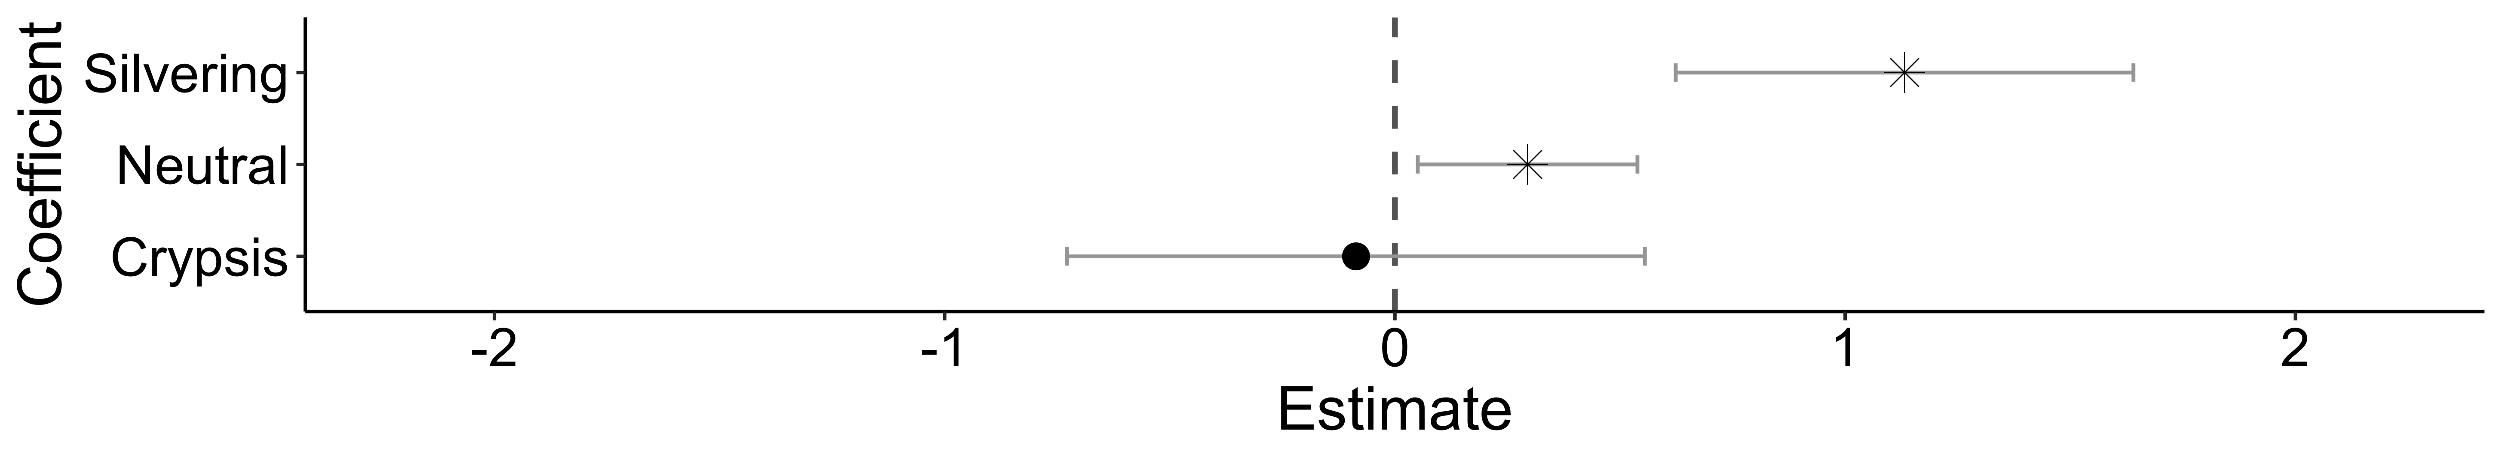
A.
Belt Transect Density Greater
SVC
Density Greater
Aggregation
schooling
Coloration
camouflage
Shape
compressiform
Species Traits
Shape*Size class
compressiform:size class
pelagic
continuous
Habitat Traits
B.
Roving
Density Greater
SVC
Density Greater
Coloration
camouflage

Slide 38
Belt Transect Density Greater
SVC
Density Greater
Aggregation
schooling
Coloration
camouflage
Shape
compressiform
Species Traits
Shape*Size class
compressiform:size class
pelagic
continuous
Habitat Traits

Slide 39
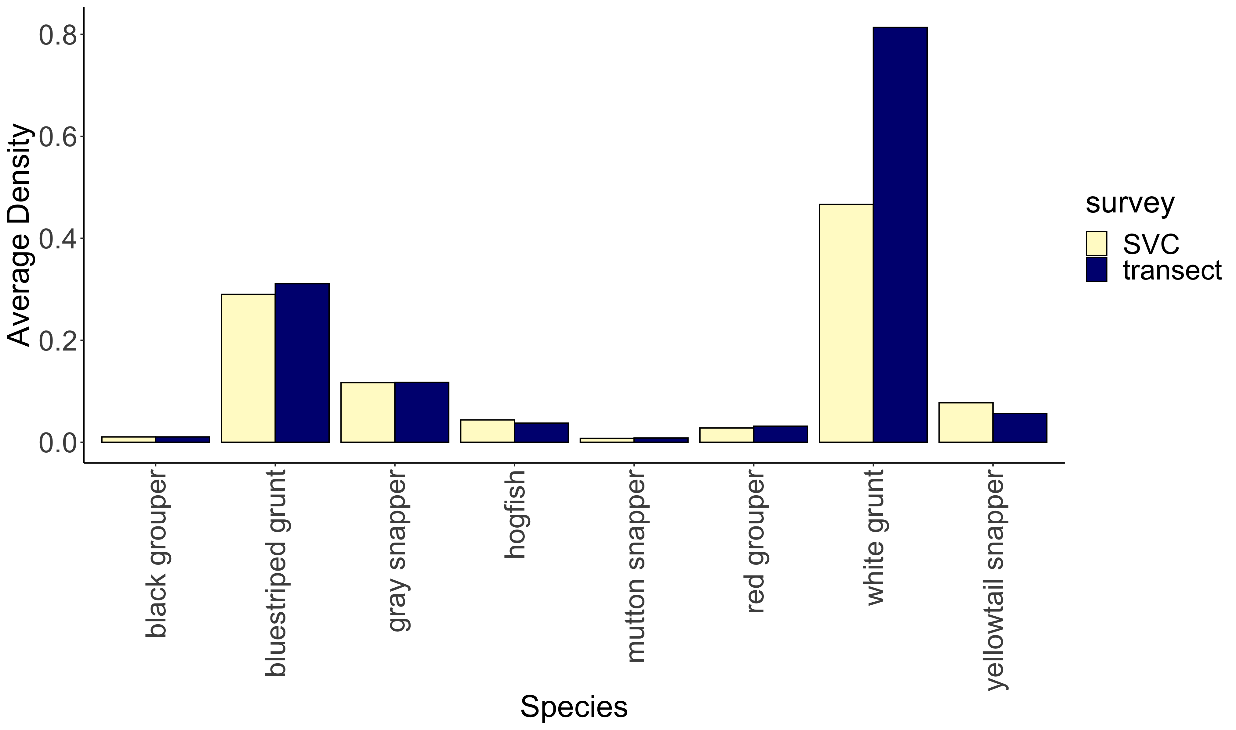
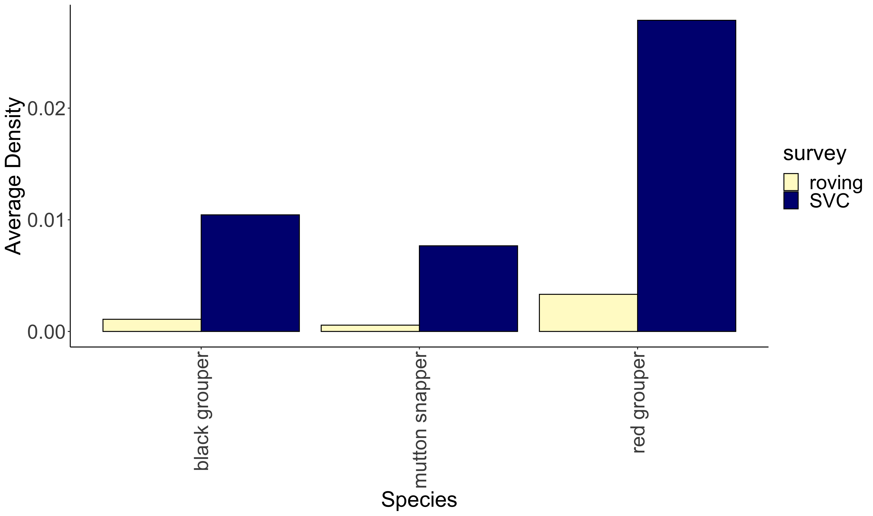
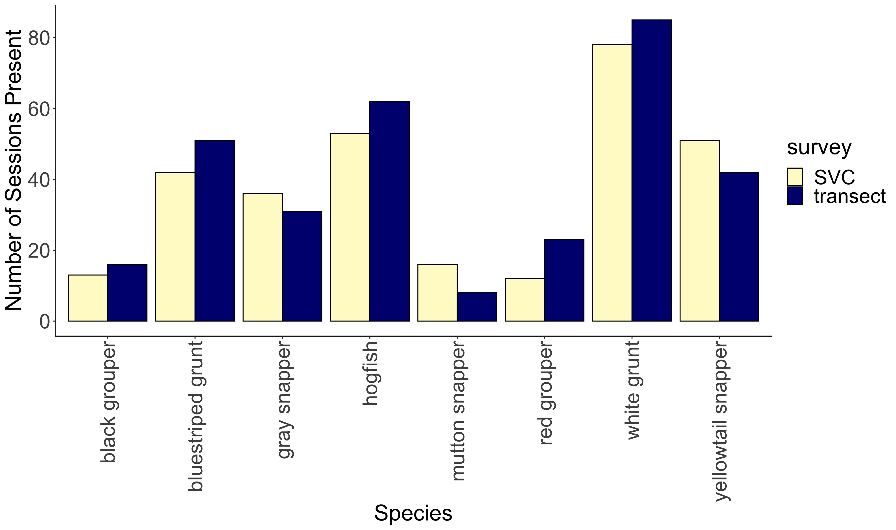
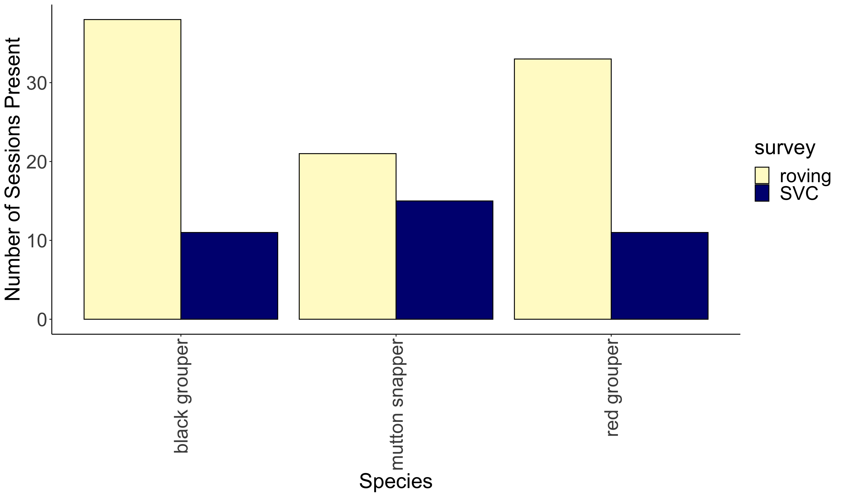
a
**
b
**
**
***
c
d
***
***

Slide 40
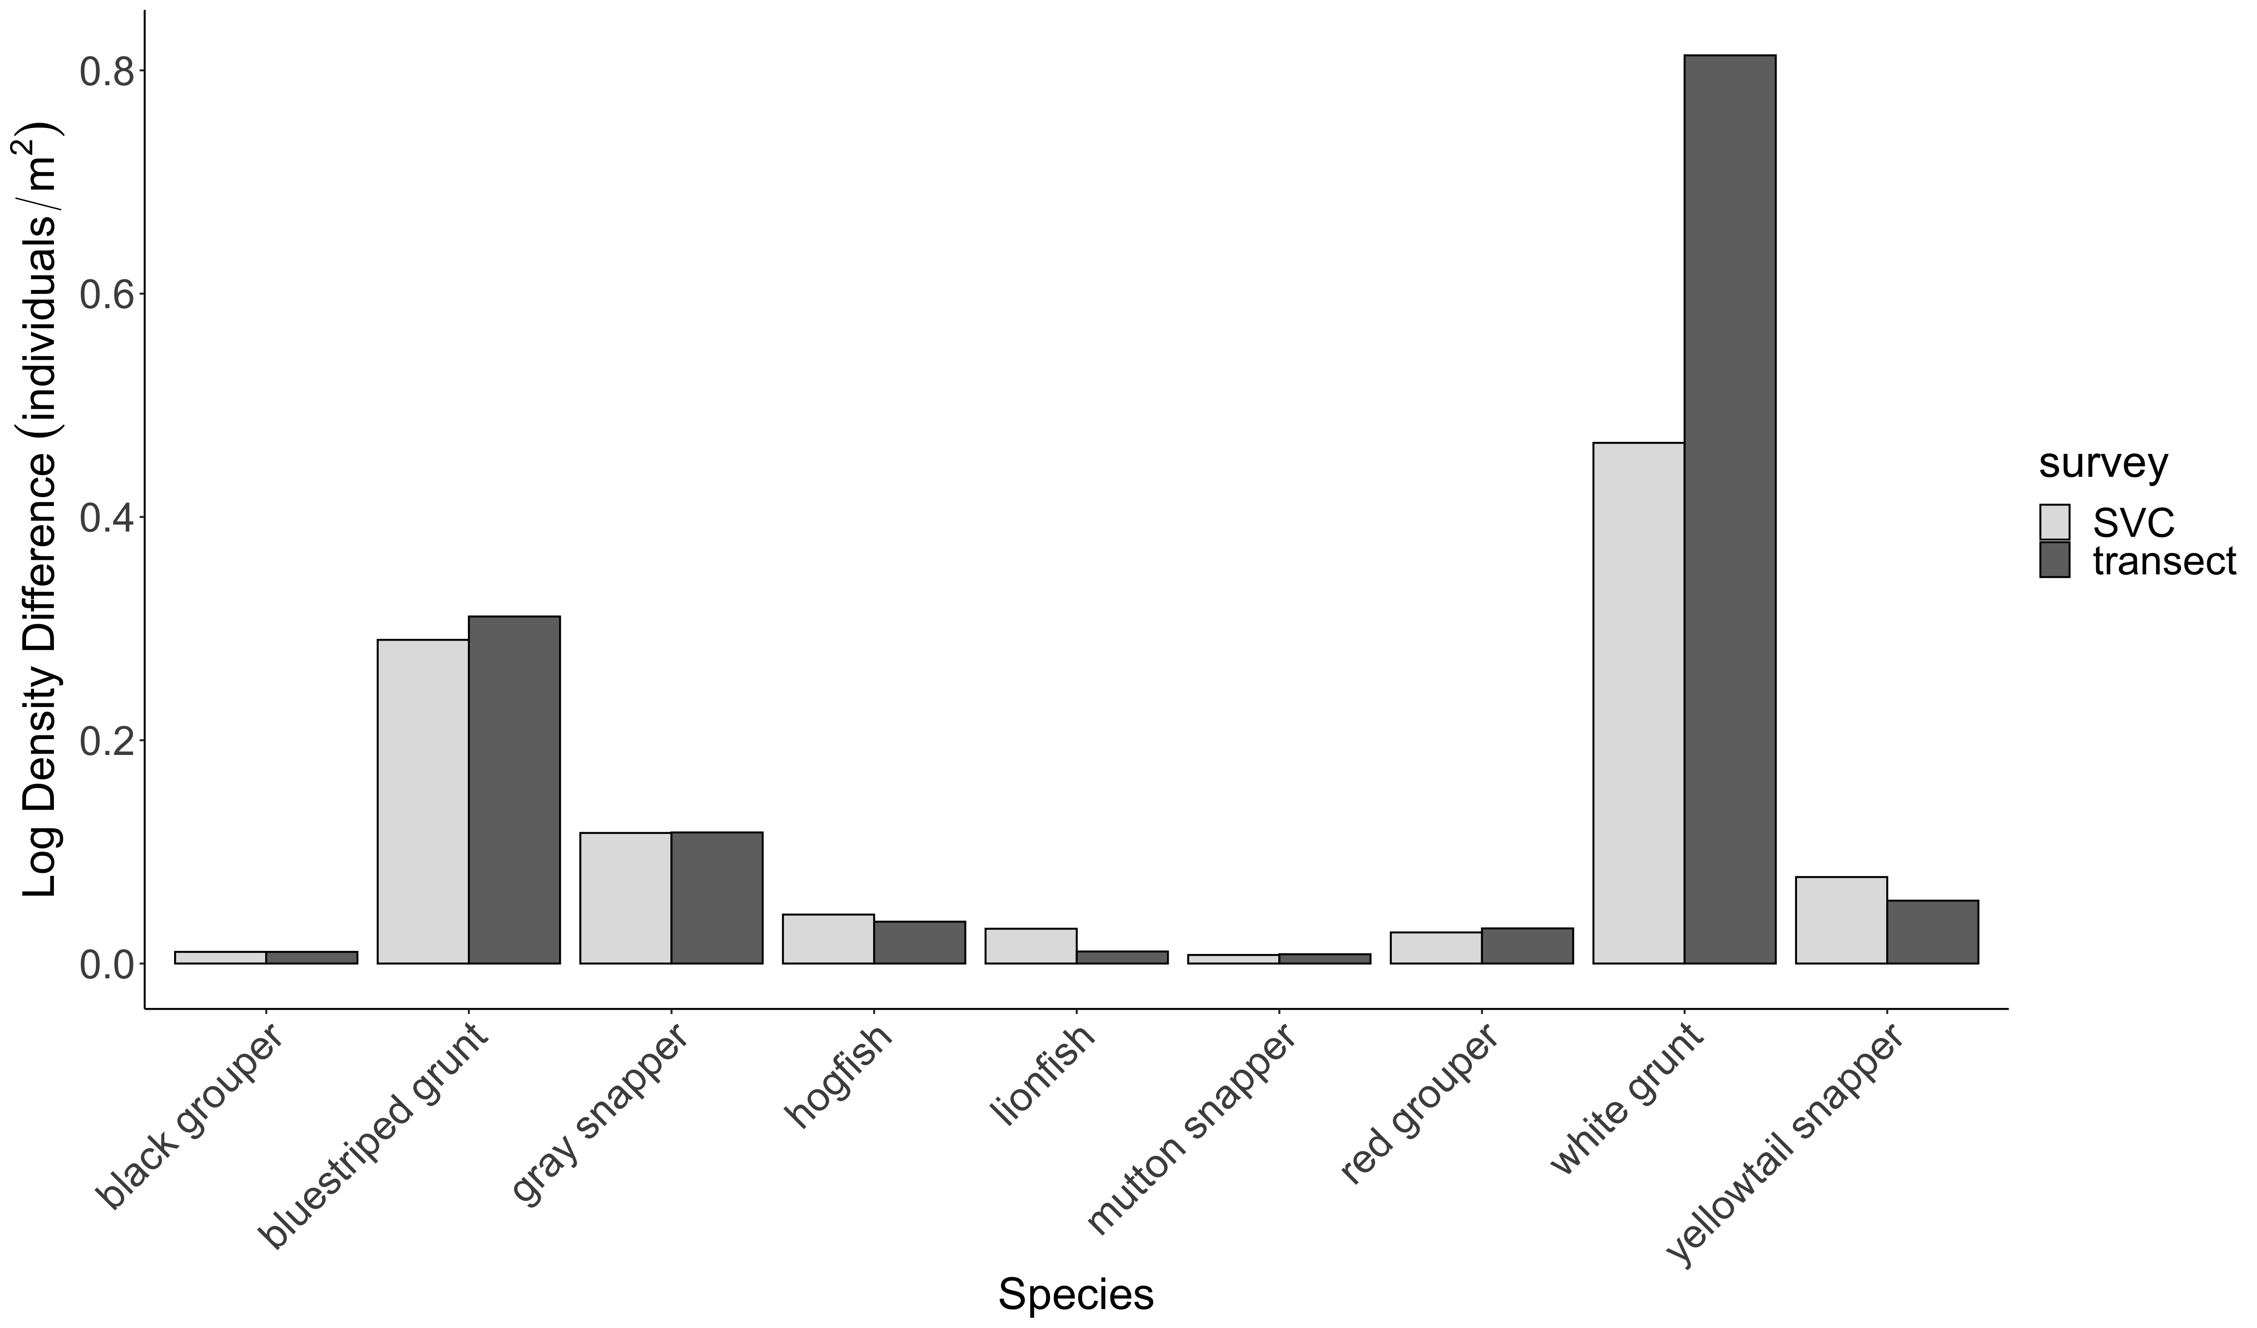



A.
C.
**
***
**
**
***
B.
D.
***
***
***

Slide 41


A.
Predictor
B.

